Slide 1
C++ with Arduino
By Adeline, Clarence and Chun Hui
SUTD ORGANIZATION OF AUTONOMOUS ROBOTICS

Slide 2
Summary of learning objectives
C++ basics
if else/else if
Loops
functions
Declaring
Variables
Logic/Relational/Arithmetic Operators
break/continue statement

Slide 3
Summary of learning objectives
Arduino Basics
Analog output with PWM
LED
Exercise
Digital Signal
Analog Inputs
Potentiometer

Slide 4
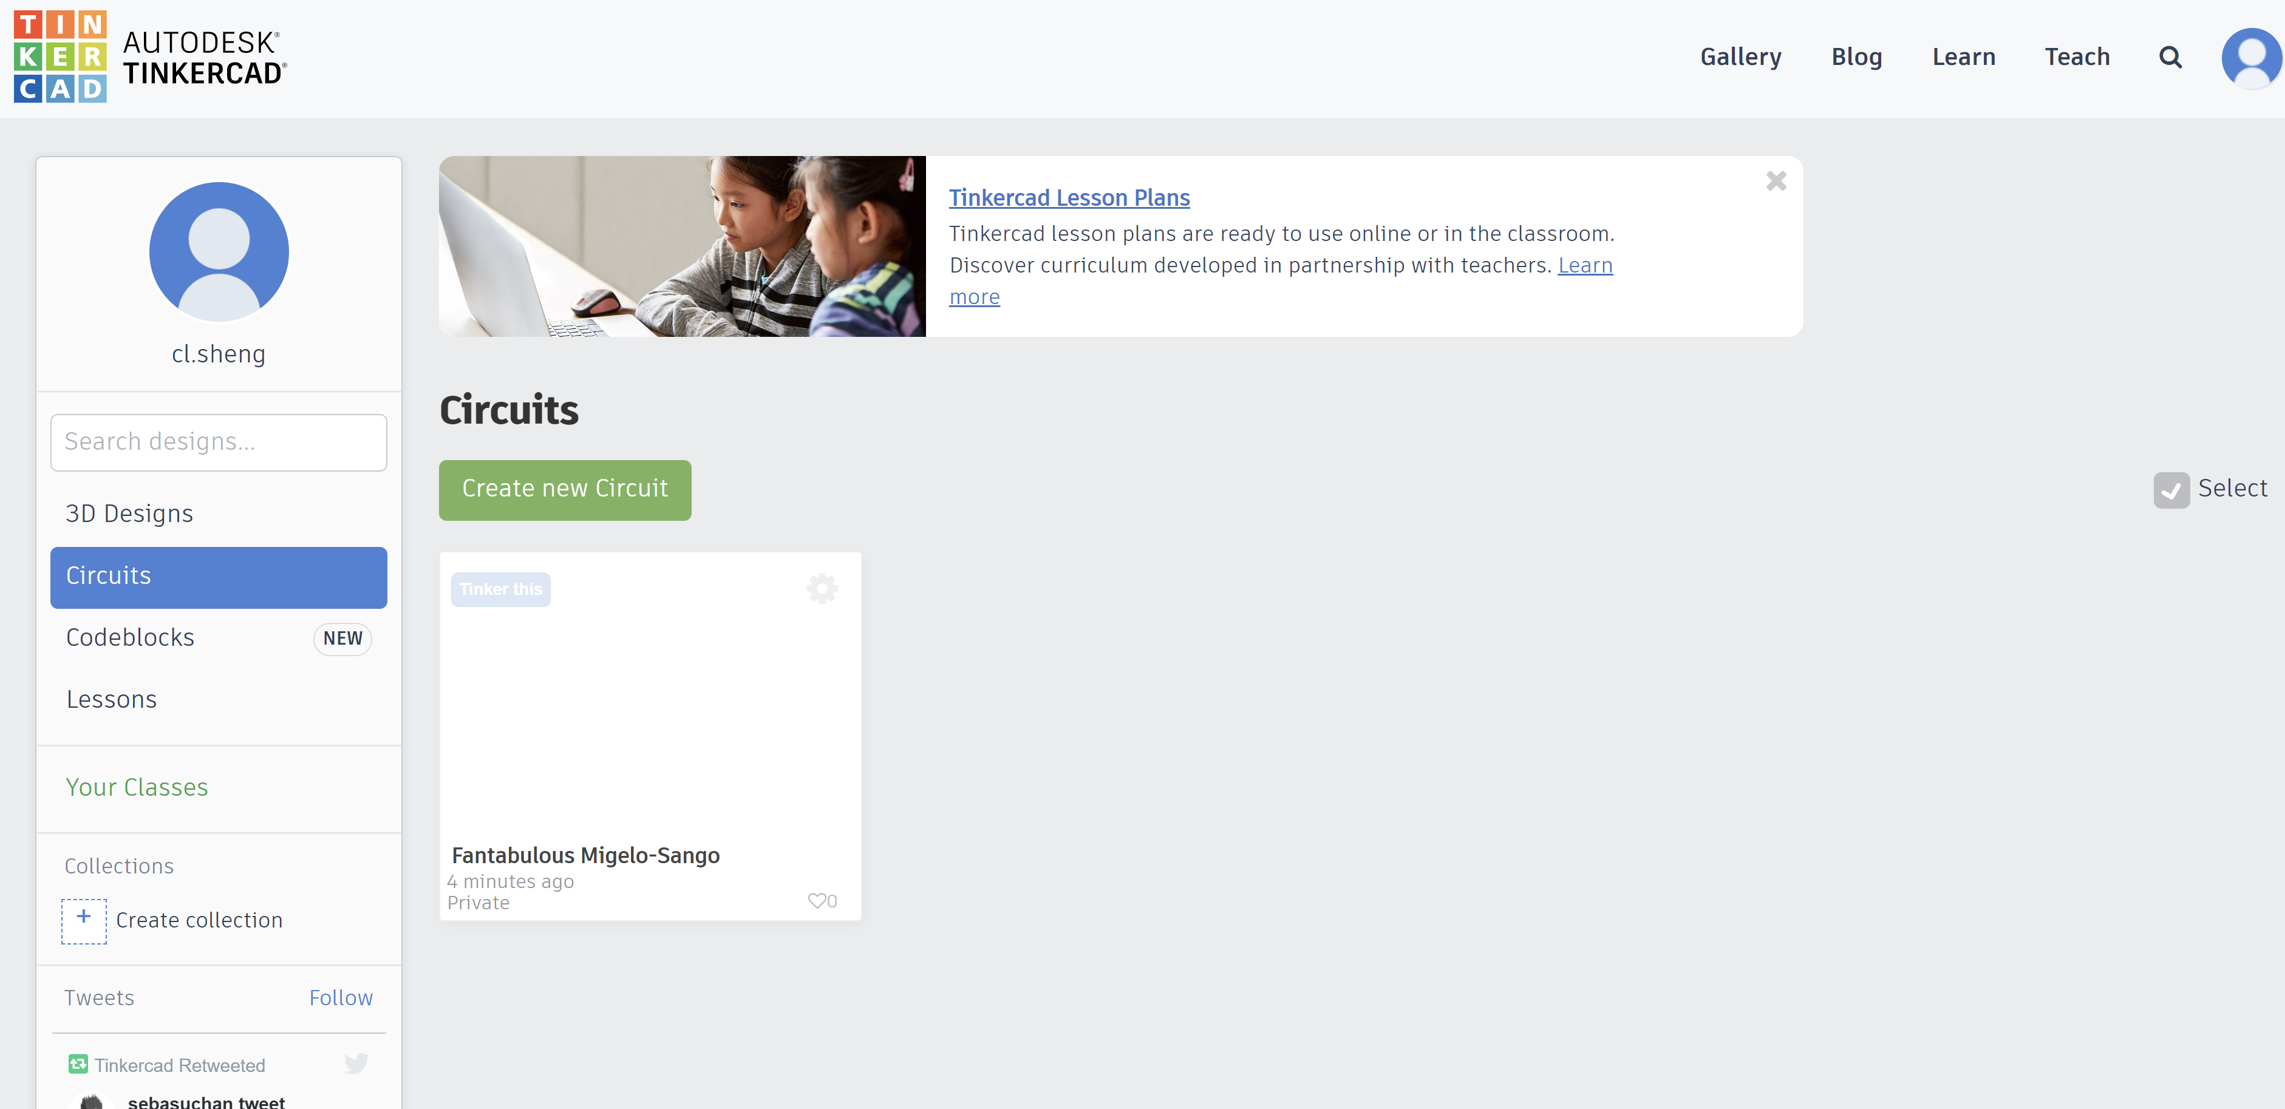
Make an account on tinkercad
Go to Circuit design Fantabulous Migelo-Sango | Tinkercad
Create an account
After creating an account click circuits, and then click create new circuit

Slide 5
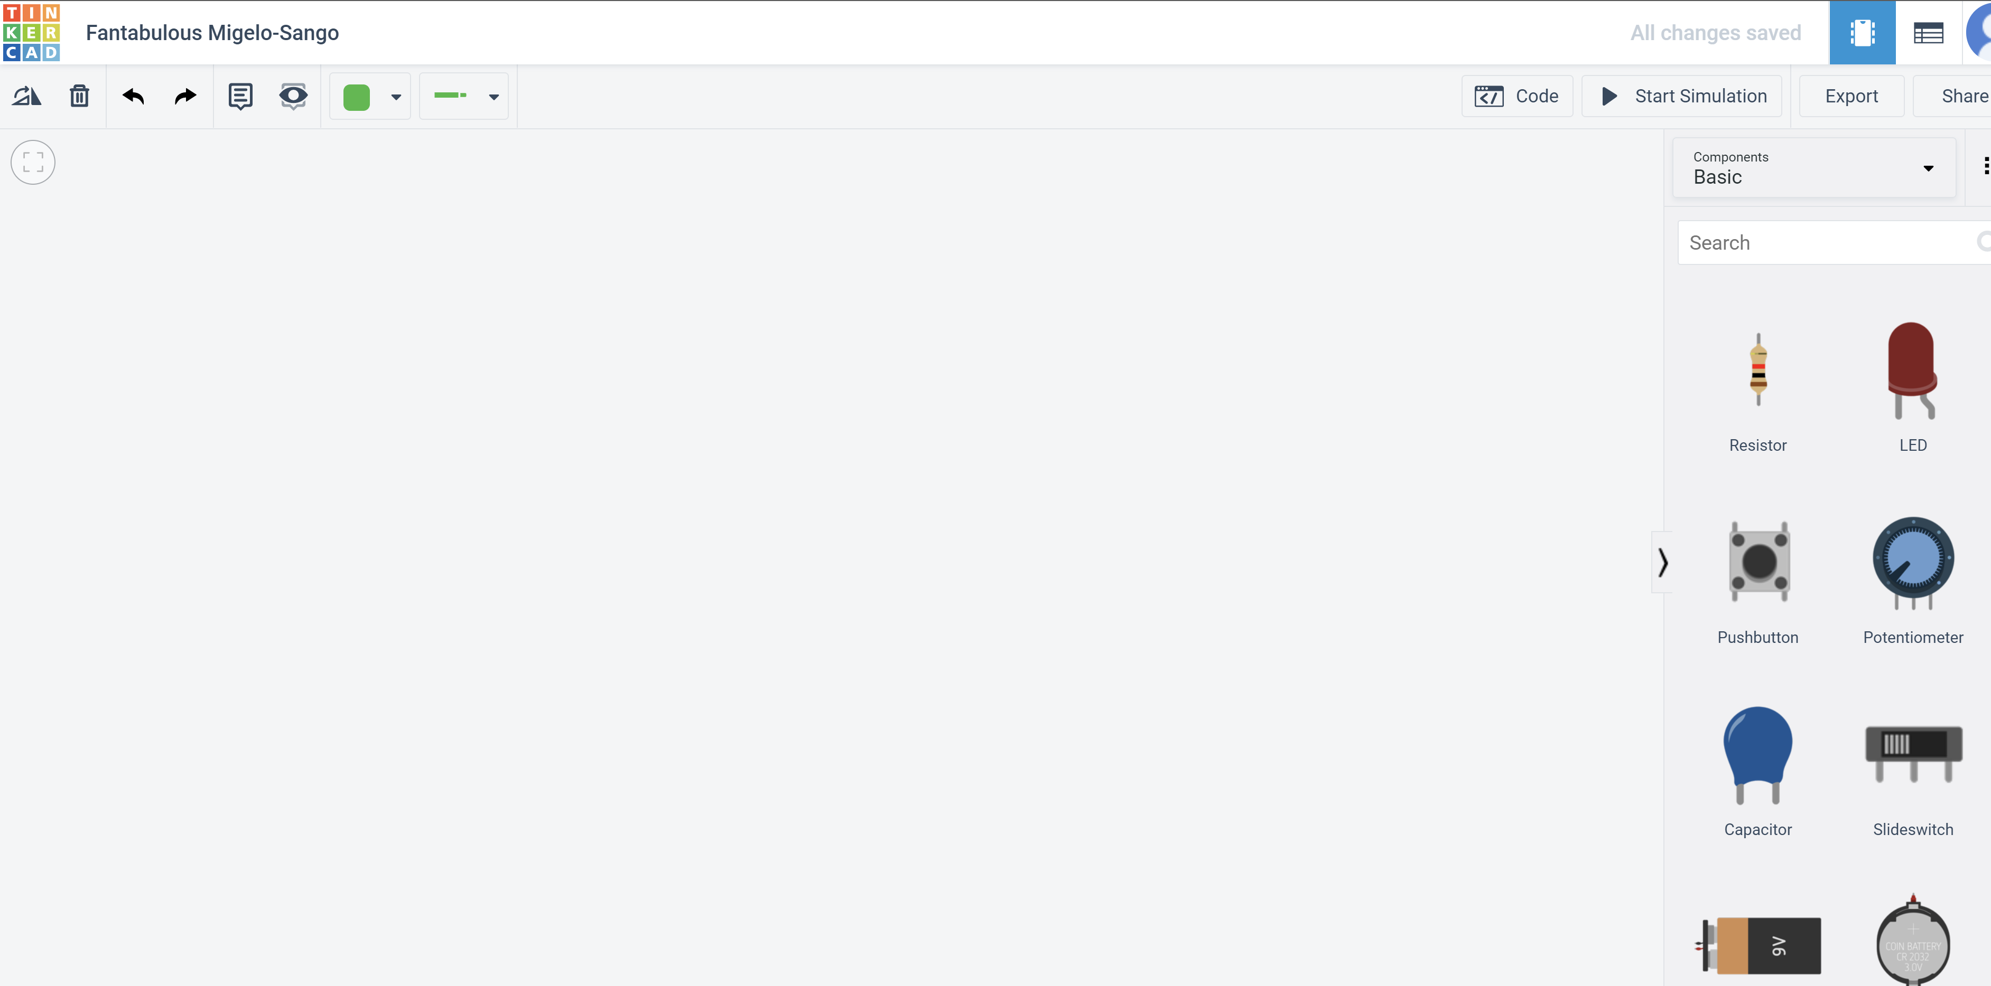
You should see a blank page with components to the right

Slide 6
What is tinkercad?
An online simulator which you can use to test your circuits

Slide 7
Chapter 1: Intro
What you will learn:
How to add components into the tinkercad environment
How to run code on the simulation
How to upload code on a physical Arduino

Slide 8
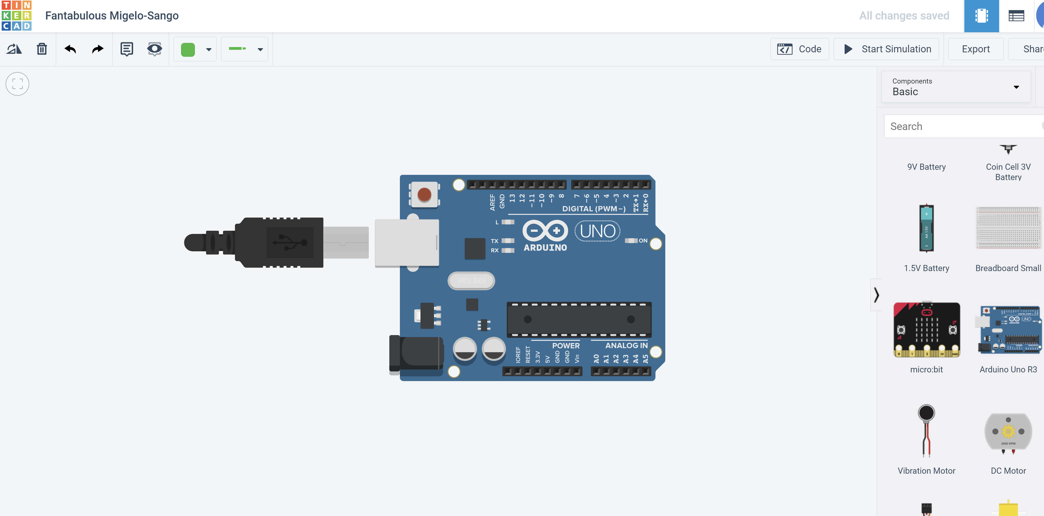
Task 1a: Add an Arduino into your environment
Search for Arduino Uno R3 on the right side of the screen

Slide 9
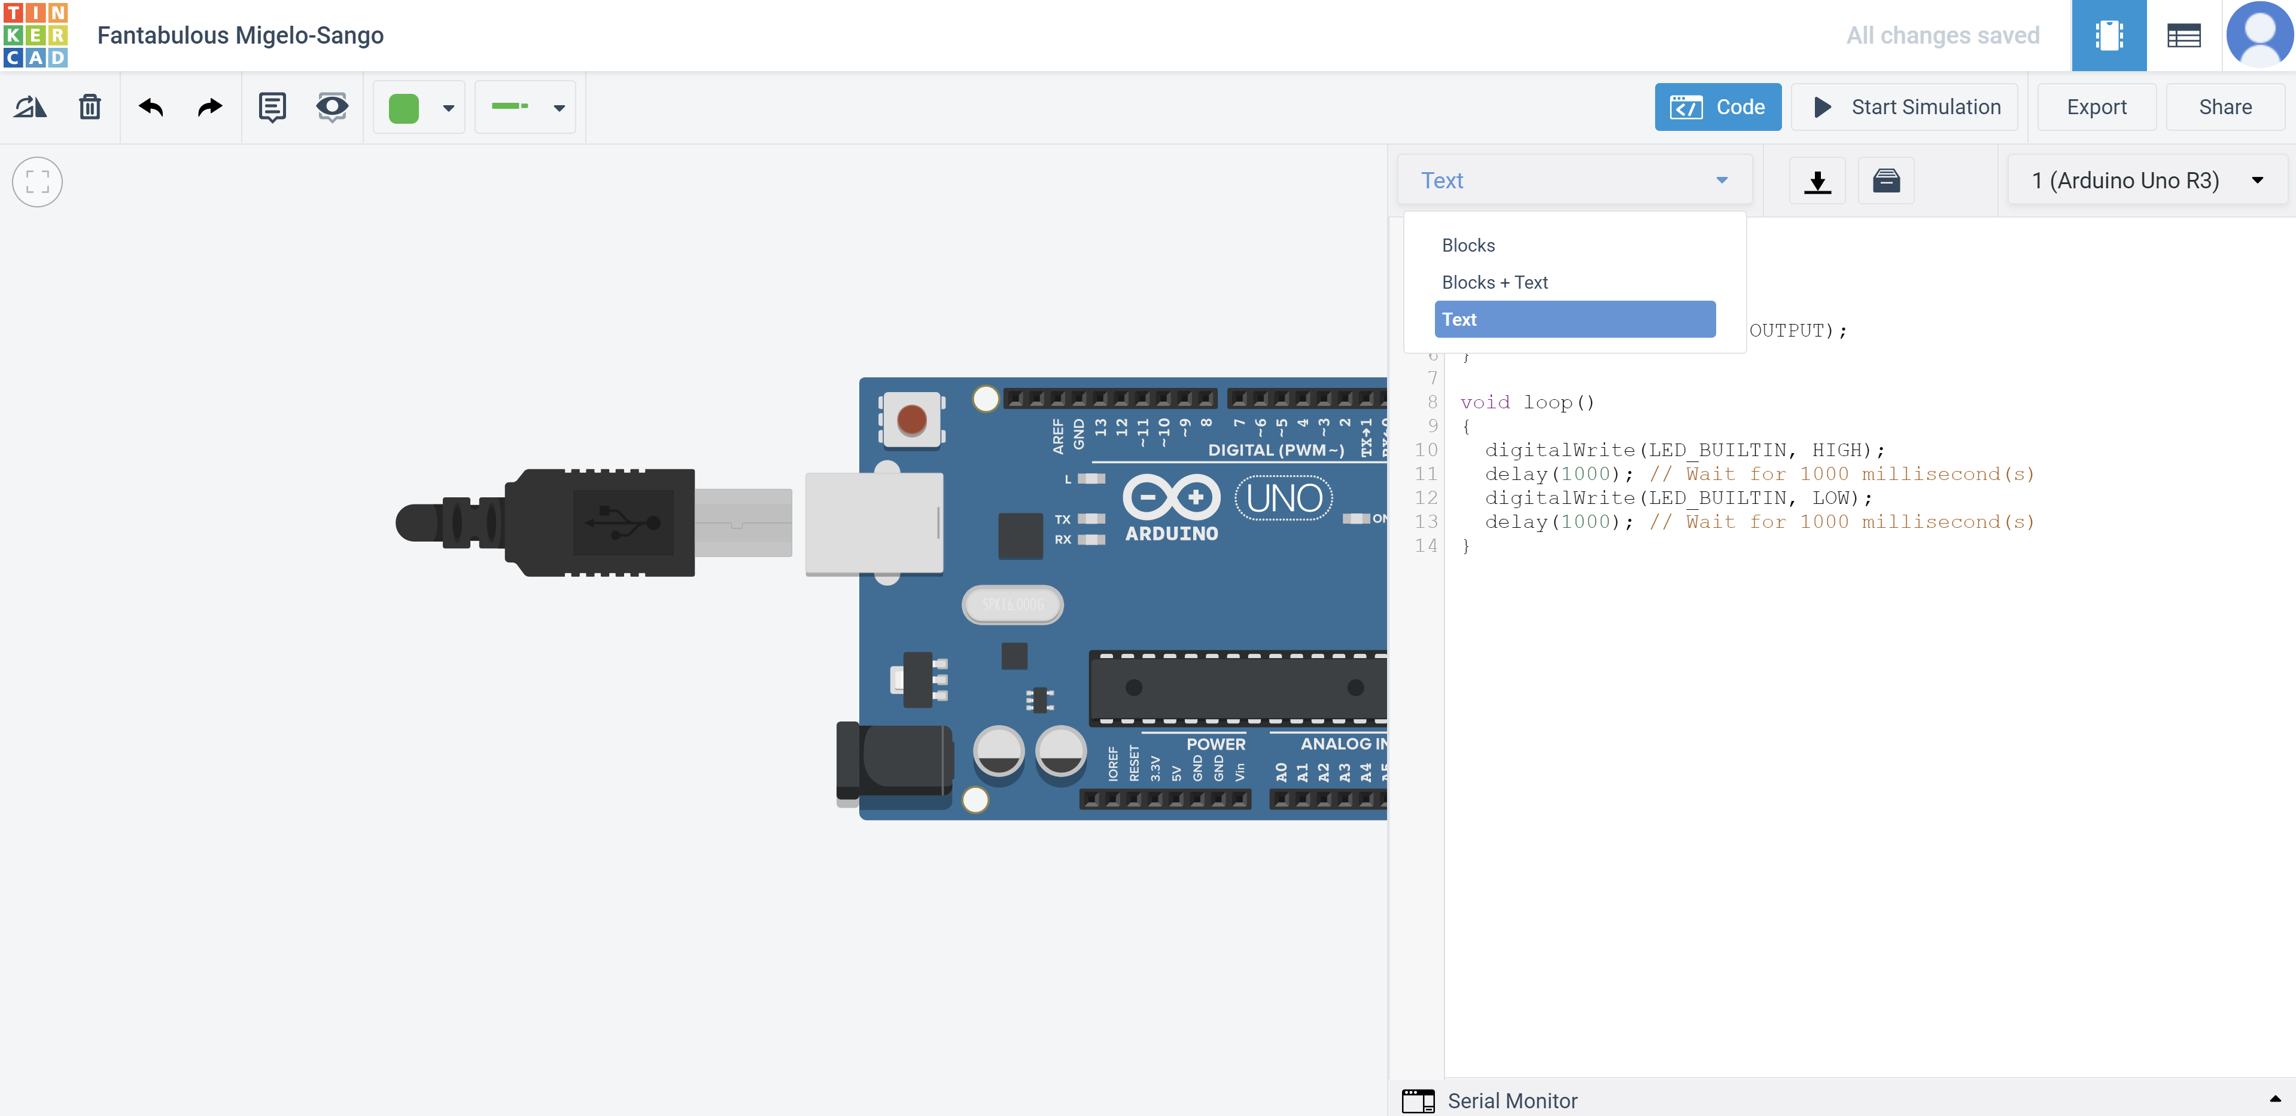
Task 1b: Run code on the simulation
Click on code
Select the dropdown
Select Text

Slide 10
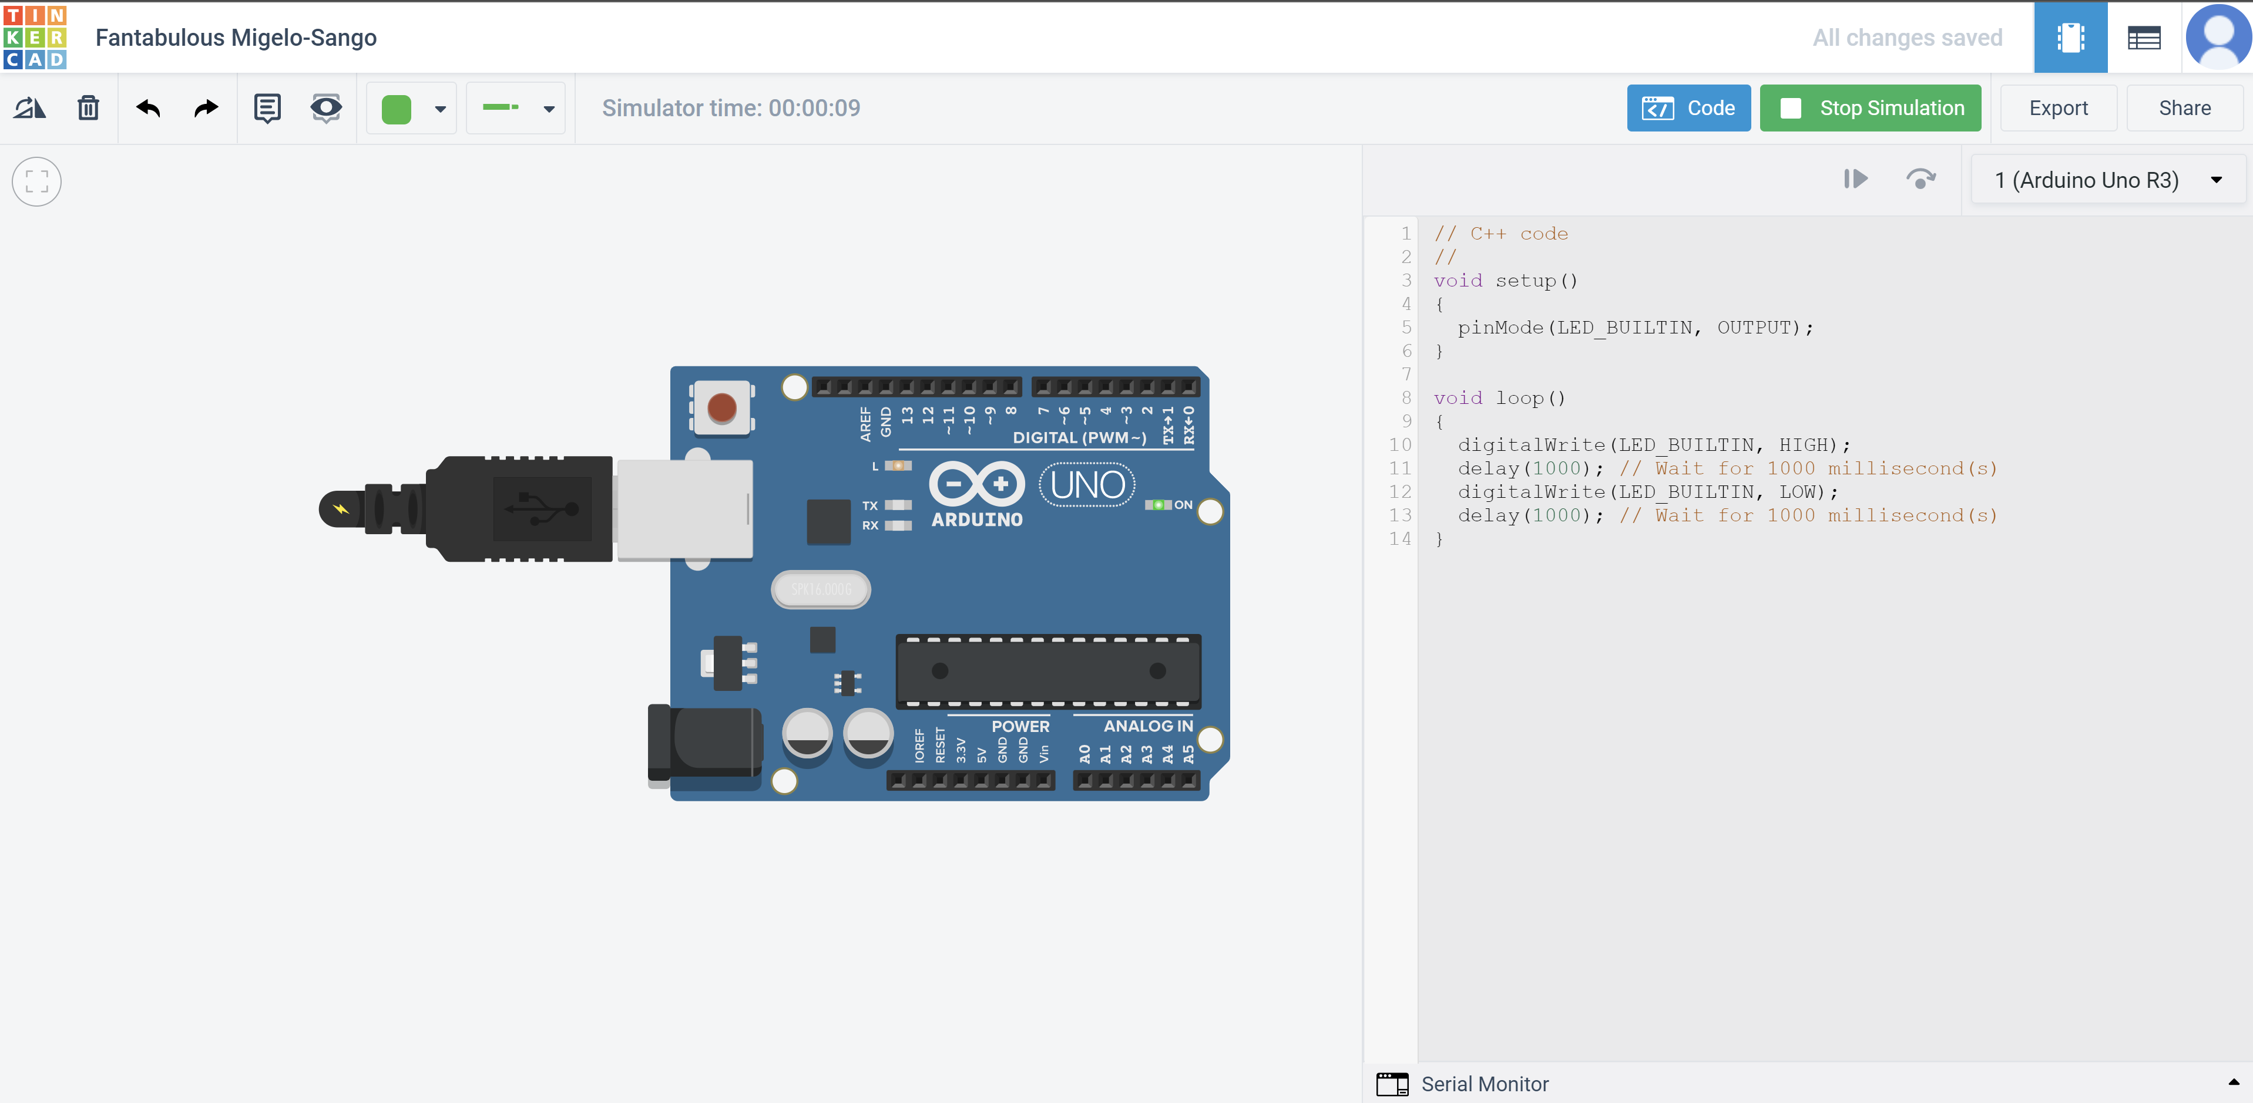
Task 1b: Run code on the simulation
Click Start simulation
You should see this flashing
This should be connected

Slide 11
Analysis of activity 1b
Where the C++ code resides

Slide 12
Analysis of activity 1b
Two functions you will see in your Arduino code:
void setup: code that you want to run once (usually all the initialisation code)
void loop: code that you want to keep running continuously (usually main programme)
Where the C++ code resides

Slide 13
Activity 1a and 1b review
We learnt how to add components into the tinkercad environment
We learnt how to upload code in the simulator
We saw a basic structure of how the C++ code will look likec
What is void setup and what is void loop

Slide 14
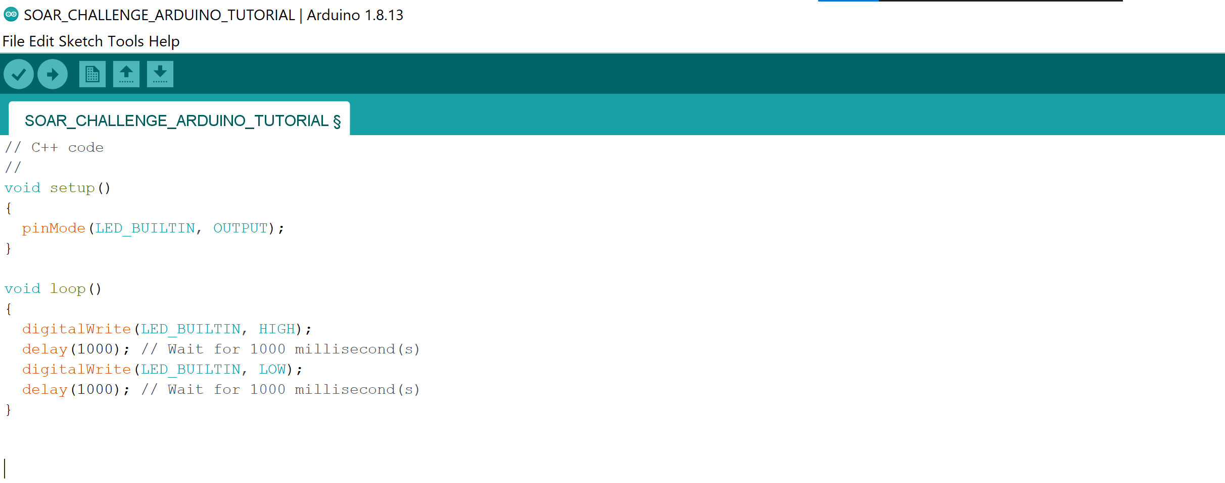
Task 1c: upload code into your arduino
Open your arduino ide and copy the code from tinkercad into your blank sketch

Slide 15
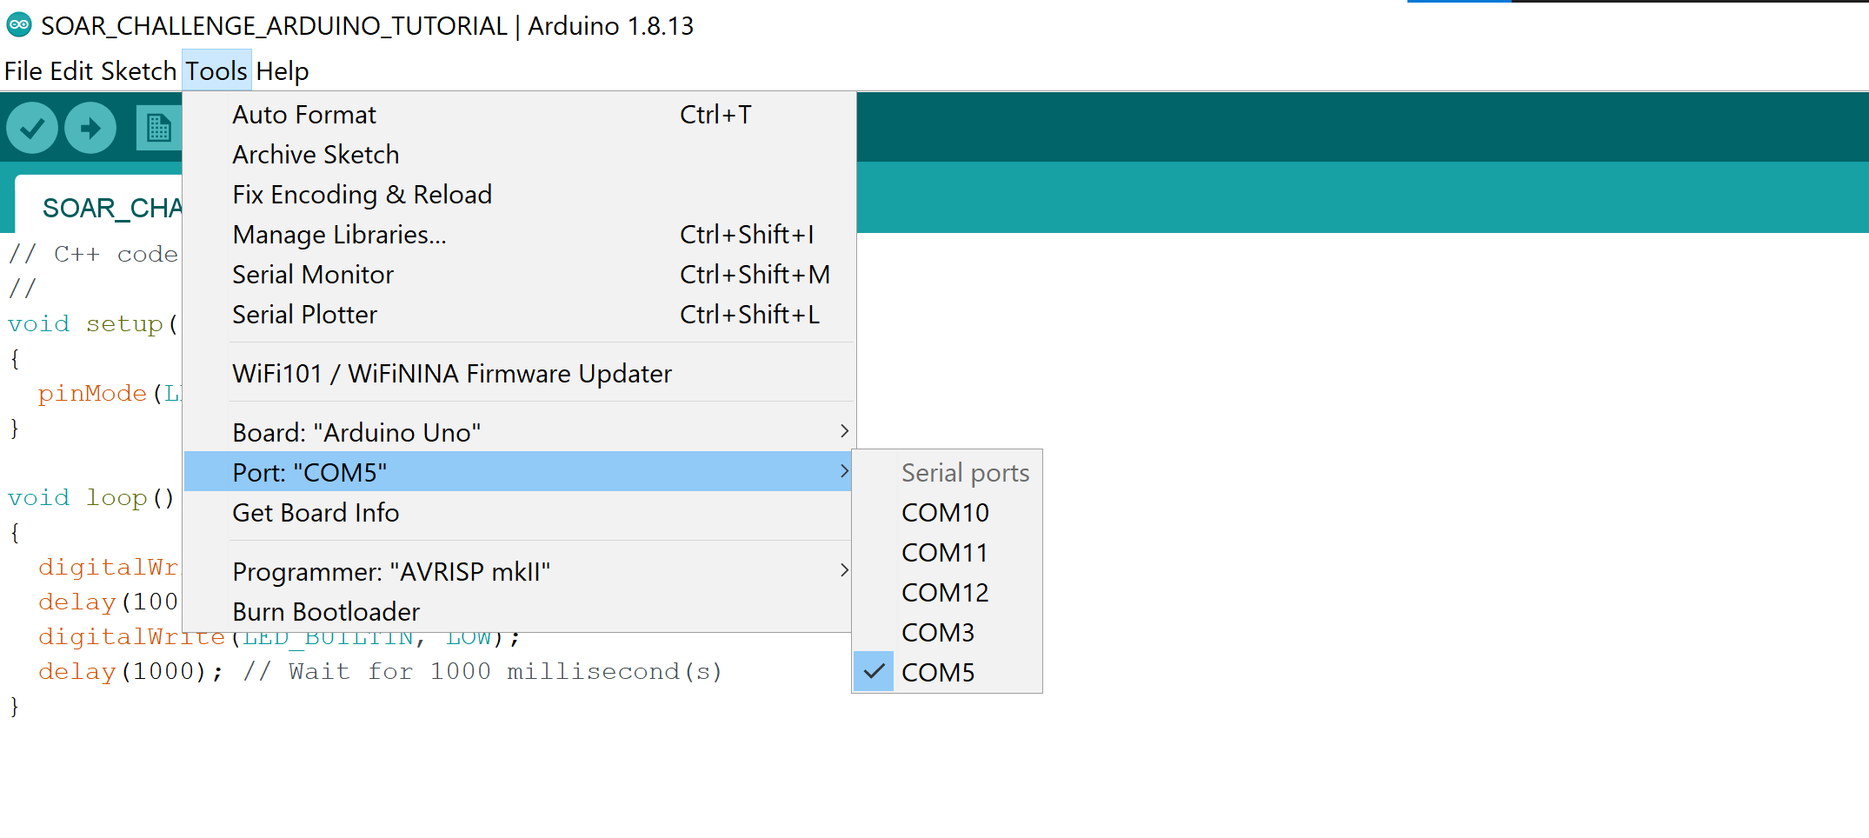
Task 1c: upload code into your arduino
Open your arduino ide and copy the code from tinkercad into your blank sketch
Choose “Arduino Uno”
Choose the correct port (Note, it may not be COM 5 on your computer, a test I do is I disconnect the arduino and see which COM port disappears)

Slide 16
Task 1c: upload code into your arduino
Open your arduino ide and copy the code from tinkercad into your blank sketch
Choose “Arduino Uno”
Choose the correct port (Note, it may not be COM 5 on your computer, a test I do is I disconnect the arduino and see which COM port disappears)

Slide 17
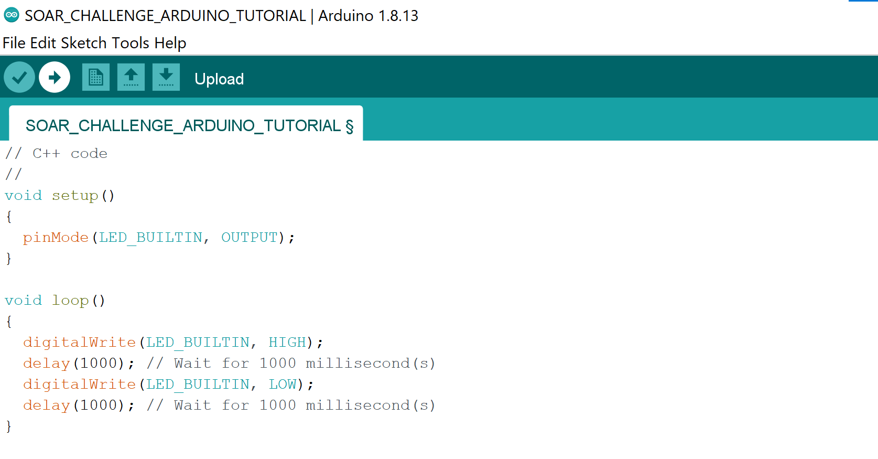
Task 1c: upload code into your arduino
Open your arduino ide and copy the code from tinkercad into your blank sketch
Click upload
You can click this compile function to make sure there is no syntax errors in your code

Slide 18

Great you are now an Arduino caterpillar

Slide 19
Chapter 2: Electronics basics
What you will learn:
Learn how to connect electronics to a breadboard
How to make an led blink
Port electronics diagram from tinkercad to physical hardware

Slide 20
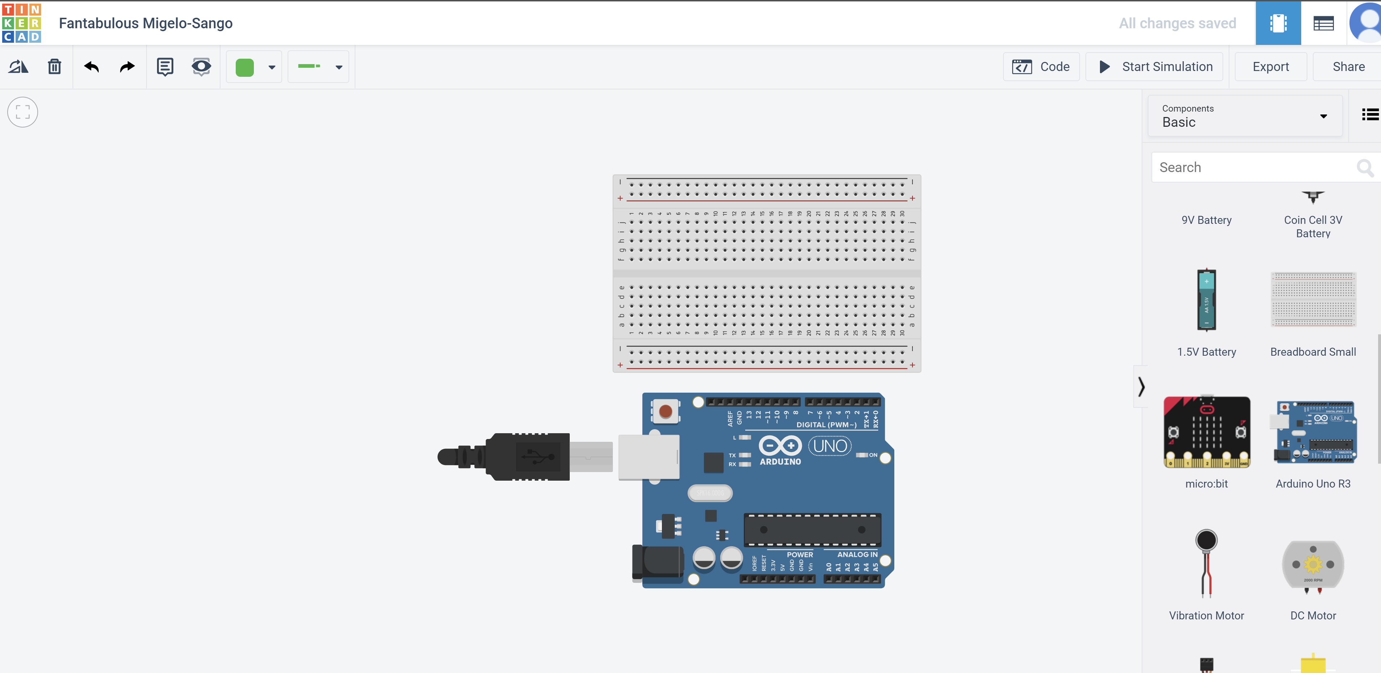
Task 2a: Add a breadboard
Click code to close the code editor
Add the breadboard in

Slide 21
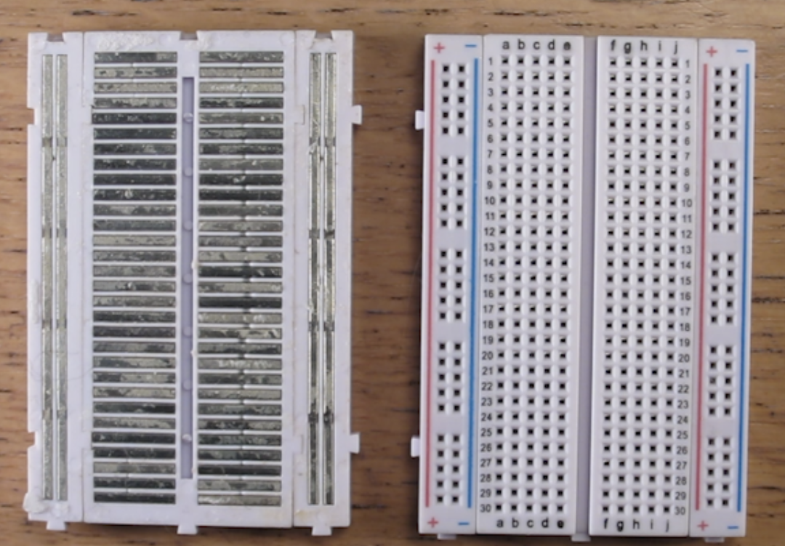
Introduction to breadboard
Metal strips allow you to conduct electricity
Note the metal strips orientation and location
As a convention, plus is used for voltage line, and the minus is used for ground

Slide 22
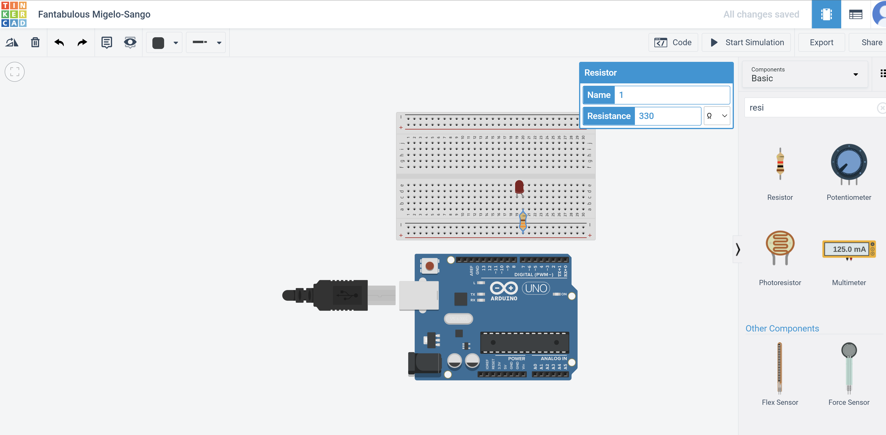
Task 2b: Add LED and resistor
Set resistance to 330 ohms (this is typically the resistor that comes with your arduino kits)

Slide 23
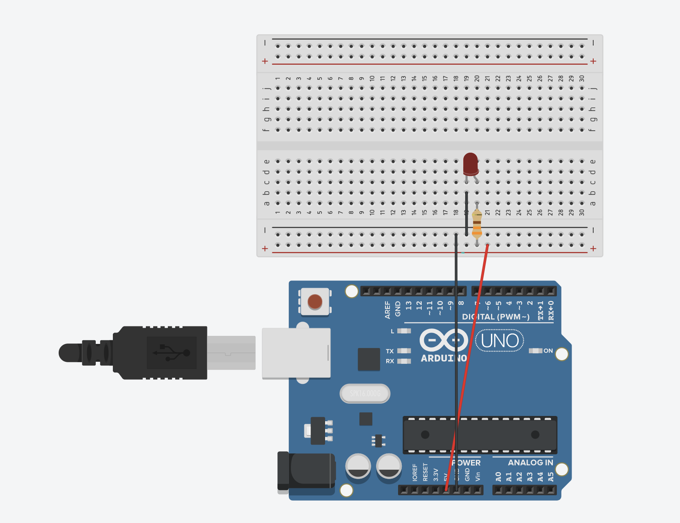
Task 2b: Connect LED and resistor
Connect the circuit
Long Leg of LED (anode) -> Resistor -> Voltage line on breadboard -> 5V on arduino
Short leg of LED (cathode) -> ground line on breadboard -> GND on arduino
Breadboard ground line
Breadboard
voltage line

Slide 24
Task 2b: Connect LED and resistor
Connect the circuit
Long Leg of LED (anode) -> Resistor -> Voltage line on breadboard -> 5V on arduino
Short leg of LED (cathode) -> ground line on breadboard -> GND on arduino
Breadboard ground line
Breadboard
voltage line

Slide 25
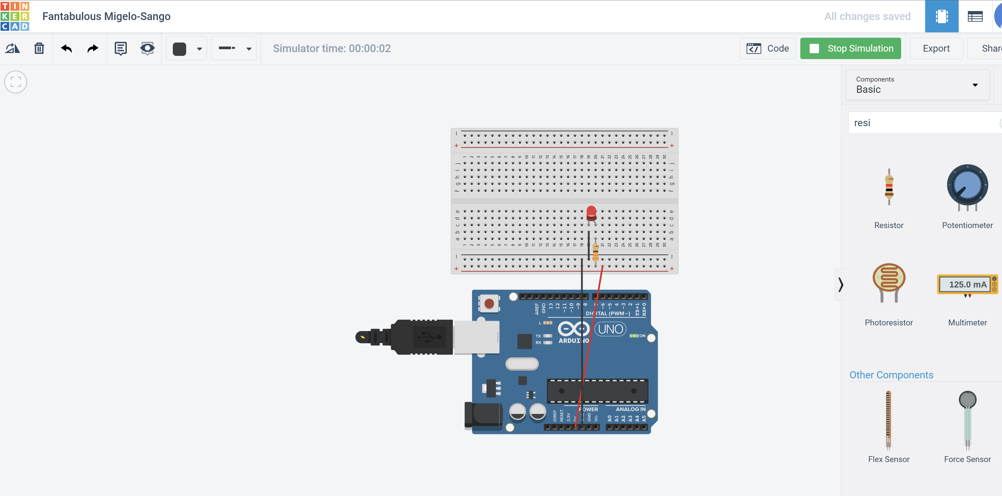
Task 2b: Connect LED and resistor
Start the simulation
You should see your LED light up

Slide 26
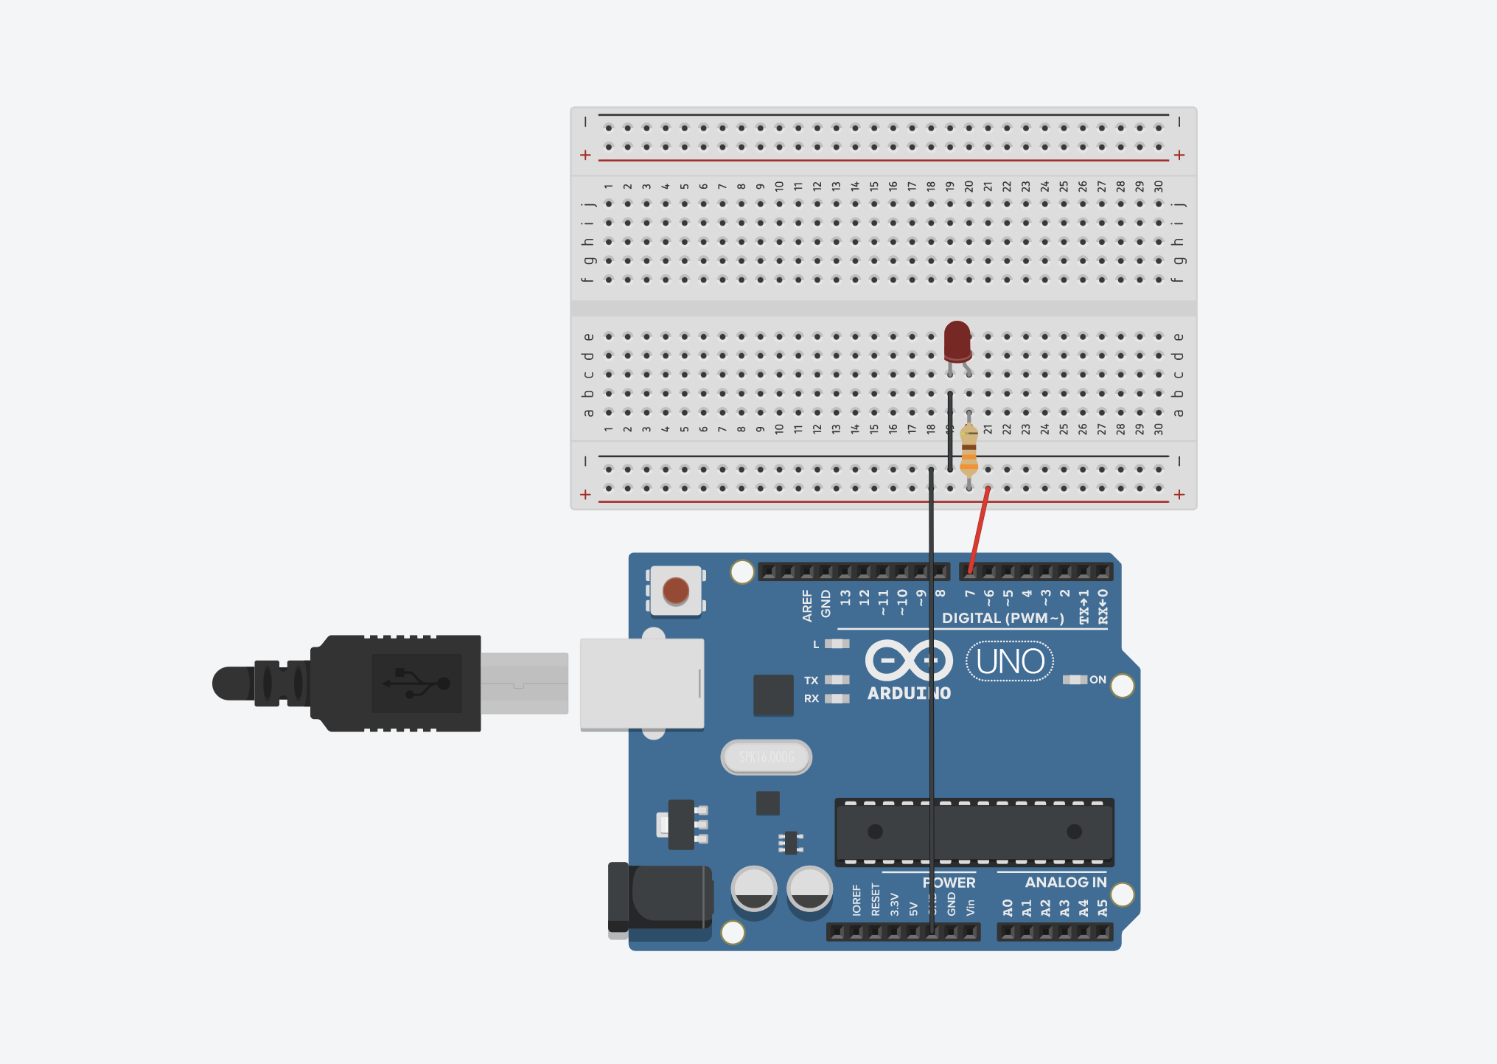
Task 2c: Blink the LED
Reconnect the pins
Shift the voltage line from 5V to pin 7

Slide 27
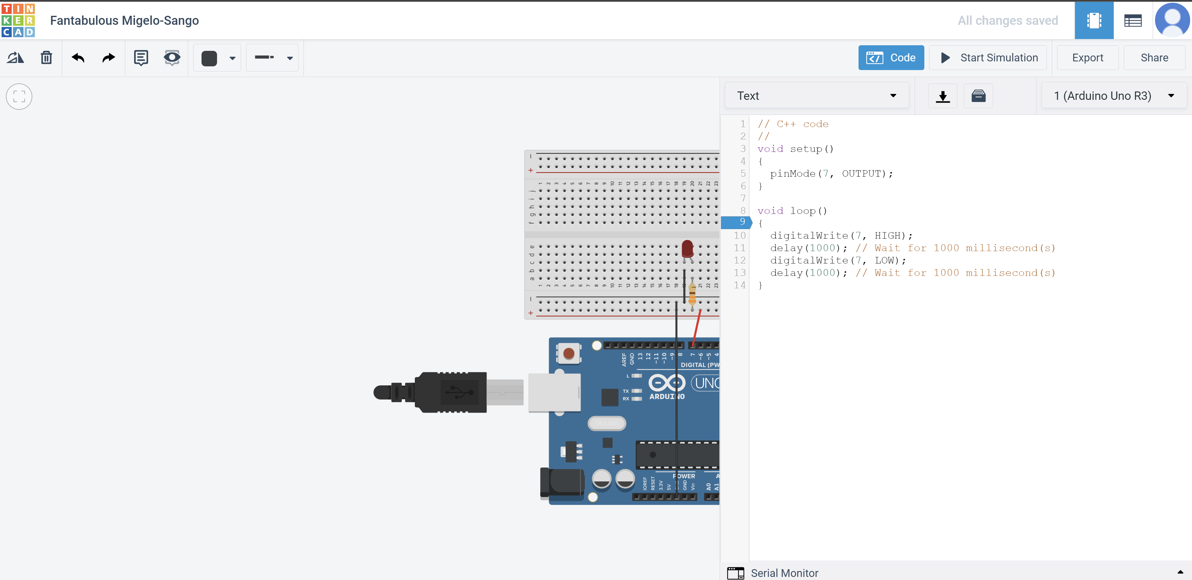
Task 2c: Blink the LED
Start your simulation and you should see your led blinking
Change the pin from LED_BUILTIN to 7

Slide 28
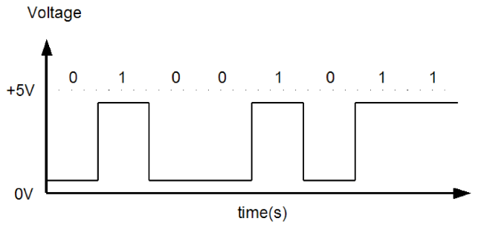
Analysis of Task 2c
Initialise pin as output at pin 7
HIGH
LOW
Send a “HIGH” signal, 5V
Send a “LOW” signal, 0V

Slide 29
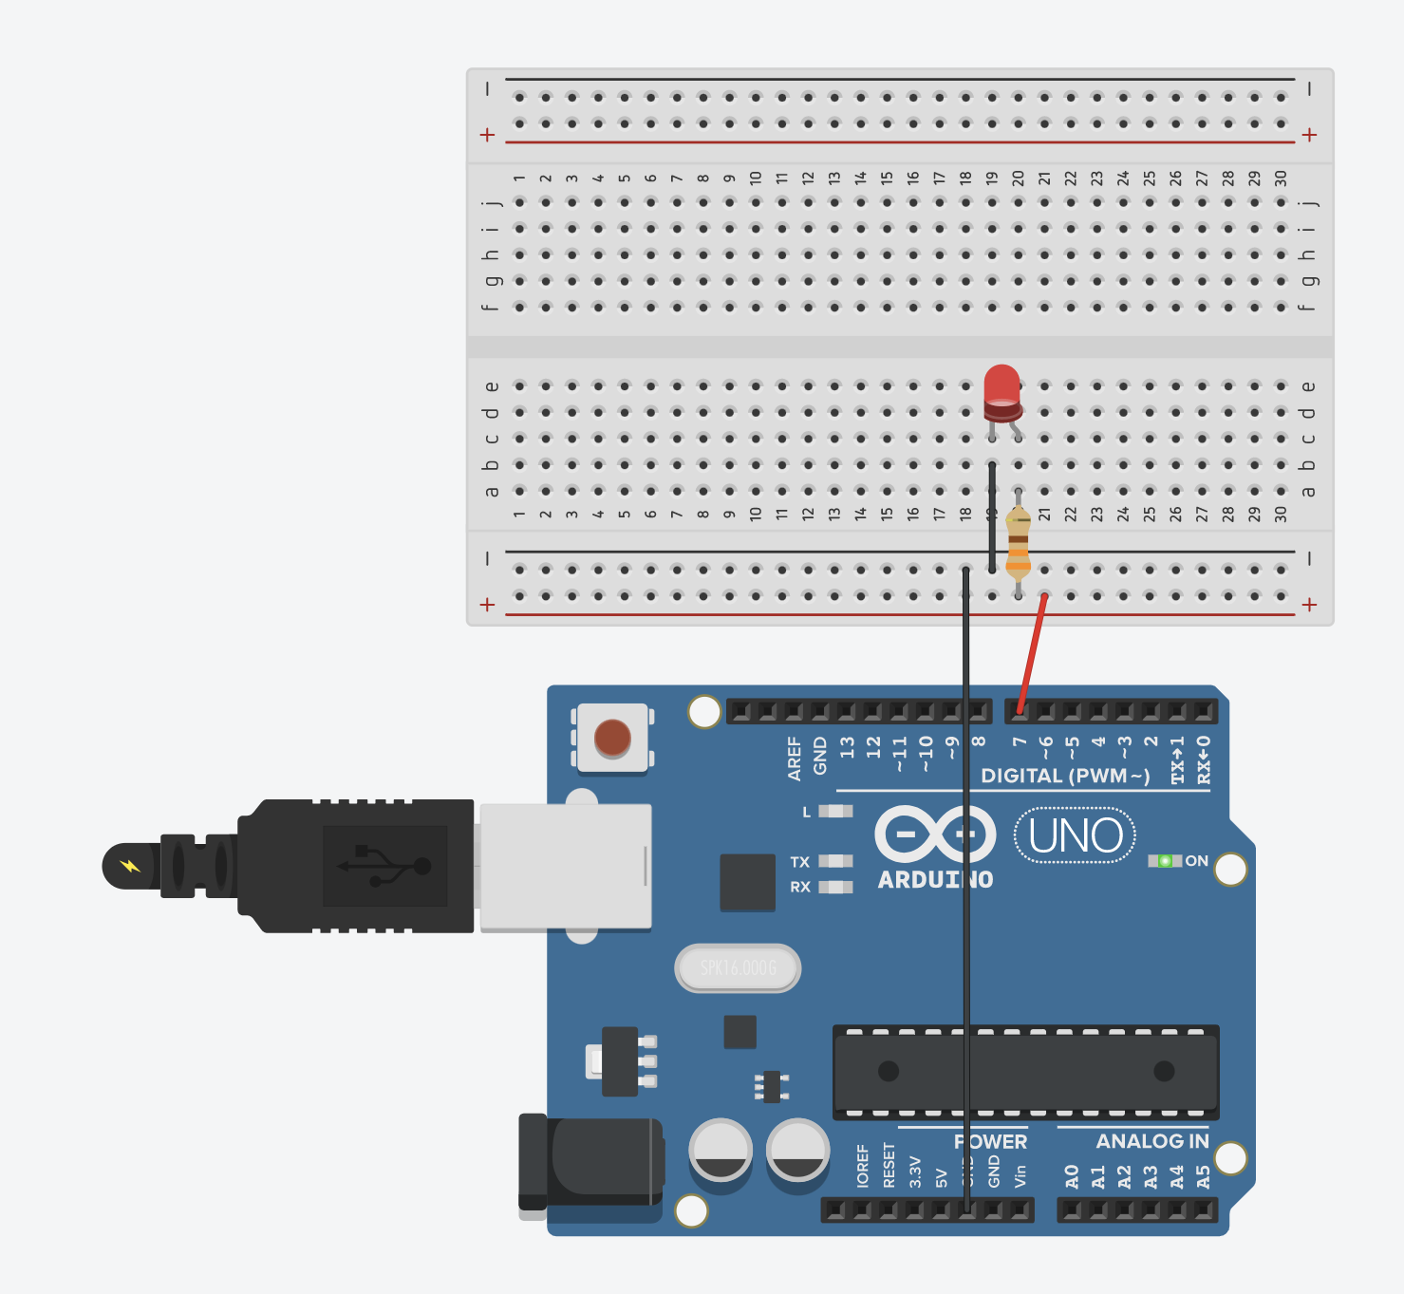
Task 2d: Replicate your blink led circuit from tinkercad to Arduino
Make the physical connection on the Arduino
Long leg of led pin to resistor
Resistor to voltage line on breadboard
Voltage line to pin 7
Short leg of led to ground line on breadboard
Ground line to gnd
Copy your blink LED code onto your Arduino ide and click upload

Slide 30
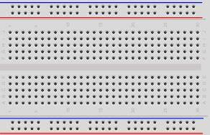
Great you are now a well fed Arduino caterpillar
I LUV BREAD

Slide 31
Chapter 3: C++ fundamentals
Serial Monitor
Variables
Conditionals
Loops

Slide 32
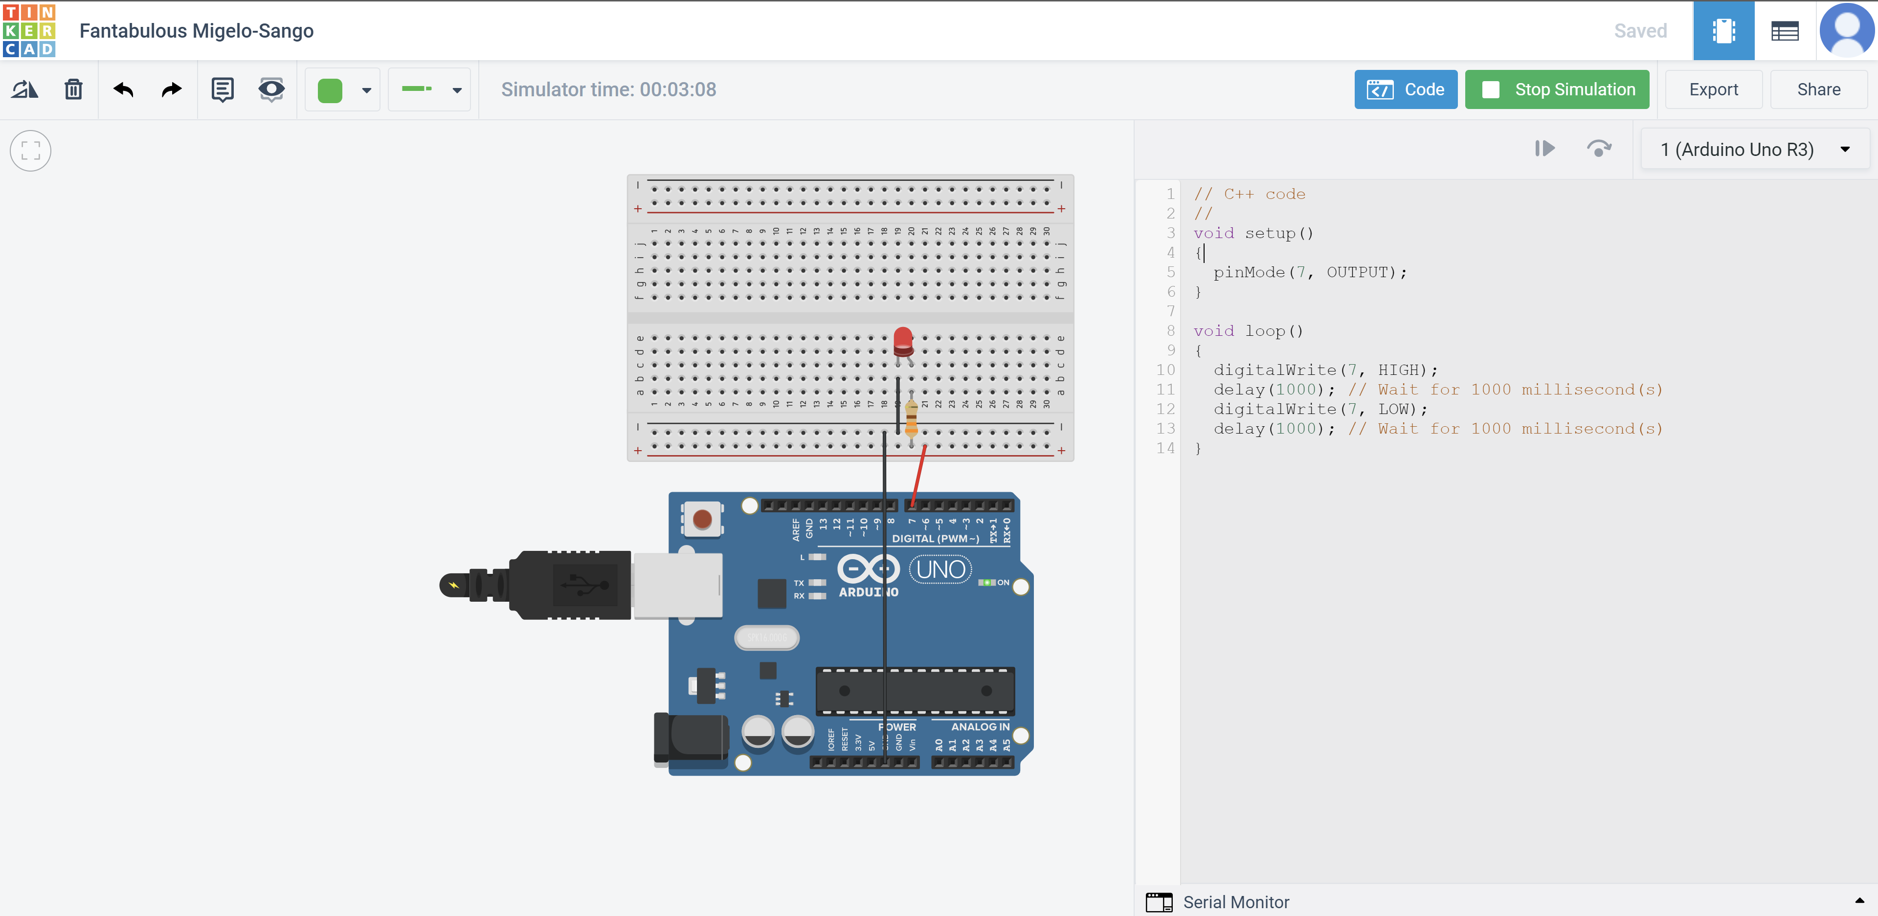
Task 3a: Learn how to use Serial Monitor
Click Serial Monitor, you should see a blank screen rise up

Slide 33
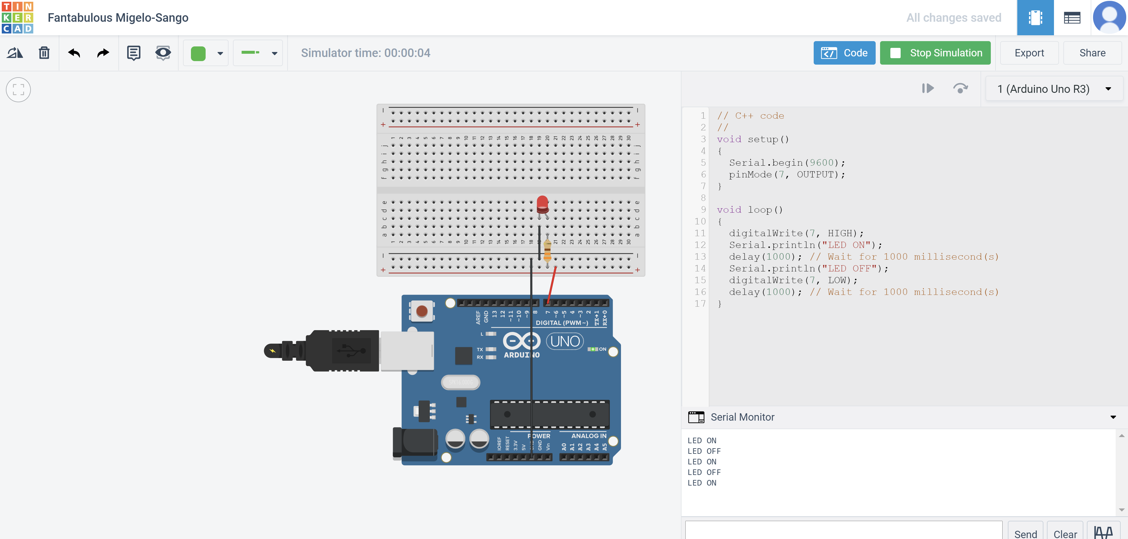
Task 3a: Learn how to use Serial Monitor
Reminder that you should stop the simulation before you can make changes to your code
Add these lines
Run simulations and you should see your messages getting printed

Slide 34
Task 3a analysis
You saw two new commands: Serial.begin and Serial.println
Serial.begin allows you to establish serial communications with the Arduino.
Serial.begin(9600): the 9600 is the baud rate, baud rate is the number of symbols per second, where a symbol can consists of more than one bit
In Arduino, baud rate is equal to the number of bits per second. E.g. Serial.begin(9600) means that 9600 bits of information is being sent per second
Serial.println allows you to print your value in the Serial monitor

Slide 35
Learning about variables
Variables are names that we give to store different values
E.g. we want to store a number 170 and call it a variable name height
E.g. we want to store the message “hello world” and call it a variable name userMessage

Slide 36
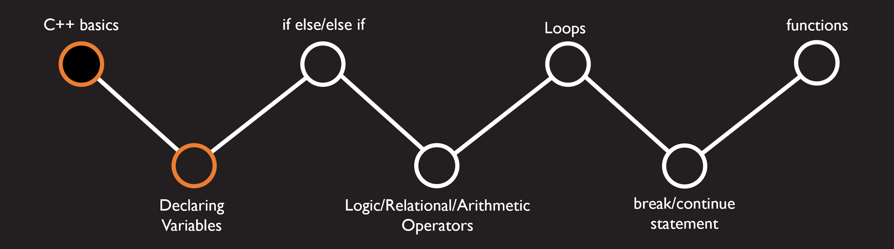
6 basic types
int -> whole numbers
char -> letters and symbols
float -> decimal numbers
double -> decimal numbers with higher precision
boolean -> true and false
void -> represents a null state

Slide 37
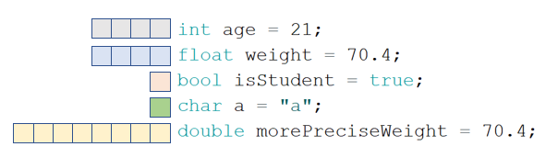
Defining variables
type variableName = value
E.g.:
Fun fact!
The number of squares beside each line is the number of bytes the variable takes up in the Arduino’s memory. (e.g. 4 bytes (32bits) for int). We see that a double takes up two times the number of bytes of float (hence two times the memory) which is why it is able to store more precise values (this precision is only evident for large numbers or when there is a lot of decimal places)
type
Variable name
value
Add semi colon after every line

Slide 38
Task 3b: Adding a variable to store our pin number
Try editing changing your voltage wire (red line) to a pin other than 7, does your code still work?
If you were to fix your code how would you change it to make it work with a new pin number?
Is changing every single number the best strategy?

Slide 39
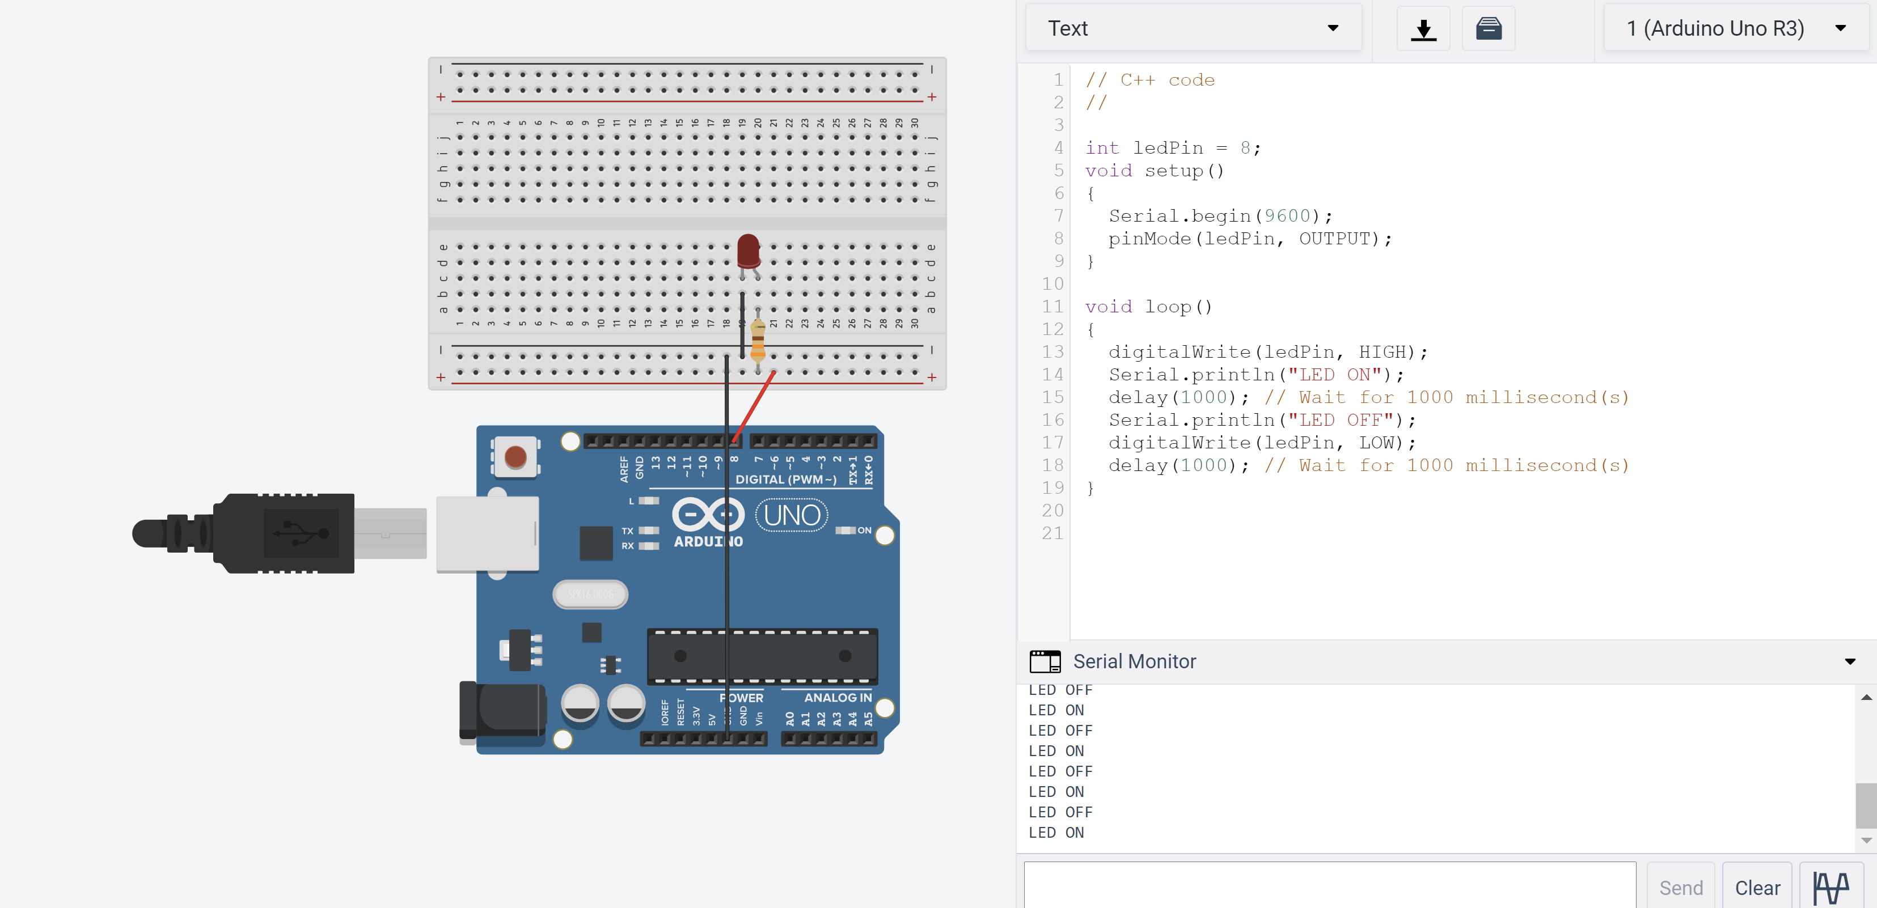
Task 3b: Adding a variable to store our pin number
Add ledPin variable
Change the number 7 to ledPin variable

Slide 40
Task 3b analysis
Adding a variable now makes it very easy for us to make changes to the code in the future (for example in this case if we need to swap pin numbers, we can just change one variable value)

Slide 41
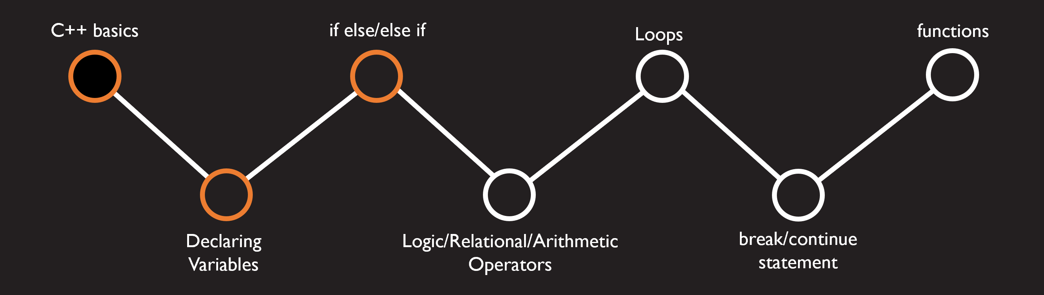
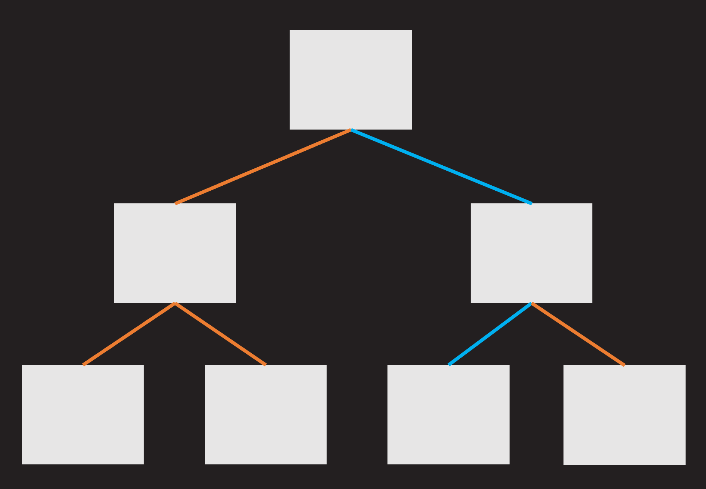
Logic, if else, else if
Programming is a series of decisions of whether to go left or right

Slide 42
Logic
In programming, this left and right is depicted in terms of 0s and 1s, or true and false
human
Light bulb
Computer
Programme
Arduino
Left
Right
Off
On
0
1
False
True
LOW
HIGH

Slide 43
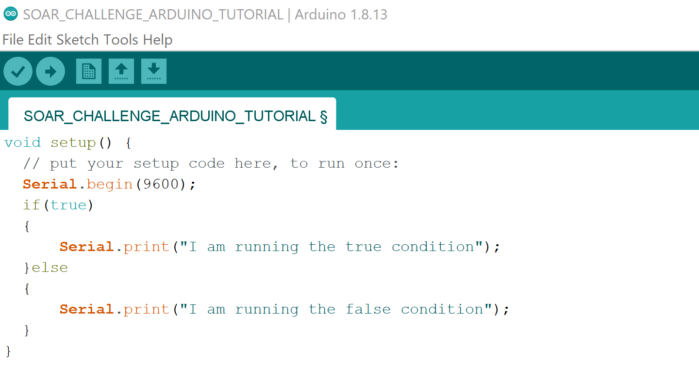
Logic: if else statement
We can direct our code to have the option of going two directions using an if else statement

Slide 44
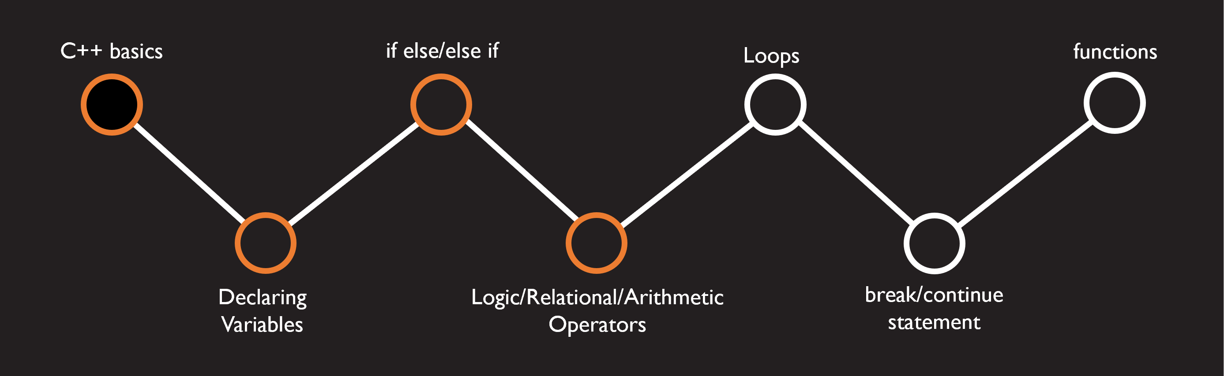
Logic operators
Arithmetic Operators
+ | addition
- | subtraction
* | multiplication
/ | quotient
% | remainder
++ | increment
-- | decrement
Relational Operators
== | Equal to
!= | Not Equal
> | Greater than
< | Smaller than
>= | Greater or equal to
<= | Smaller or equal to
Logical Operators
! | not
&& | and
|| | or

Slide 45
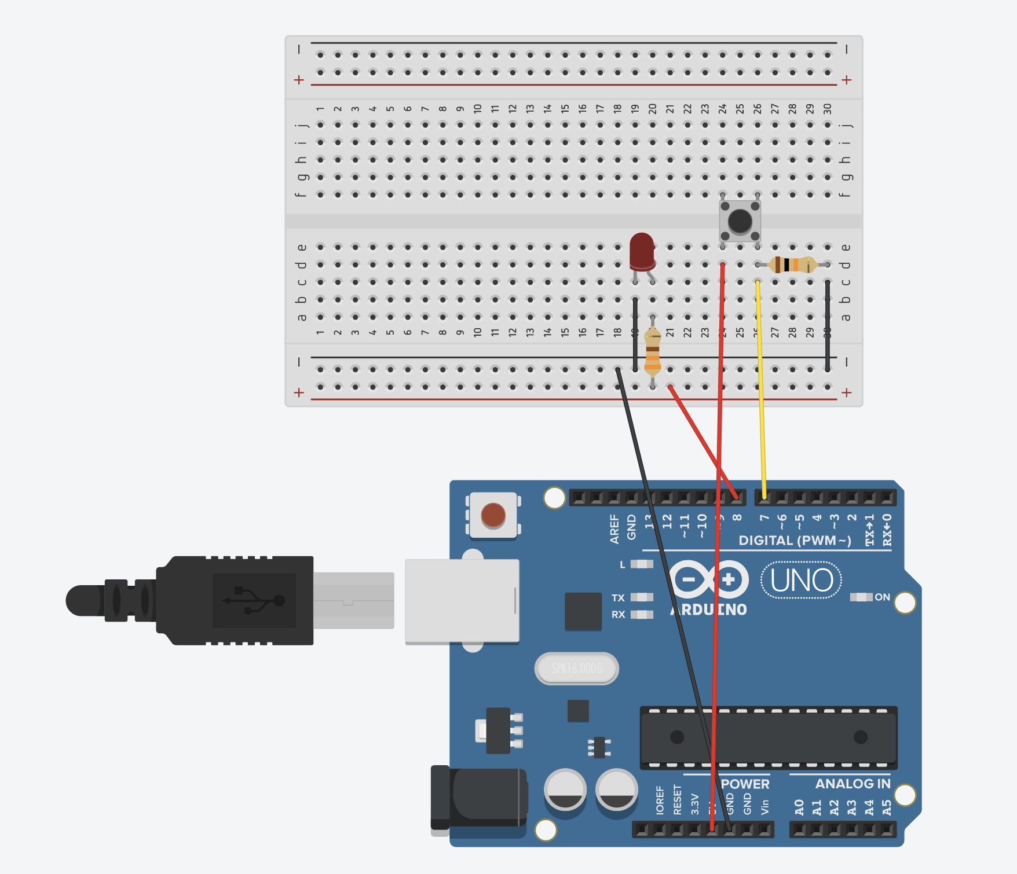
Task 3c, use if else statement to on and off the led
Setup your circuit as shown in the diagram:
5V to switch
Switch to resistor
Resistor to Ground line
Switch to pin 7
Fun fact!:
The resistor used in the push button in this setup is called a pull down resistor, if you are interested why we need to use a pull down resistor feel free to ask us after the class!

Slide 46
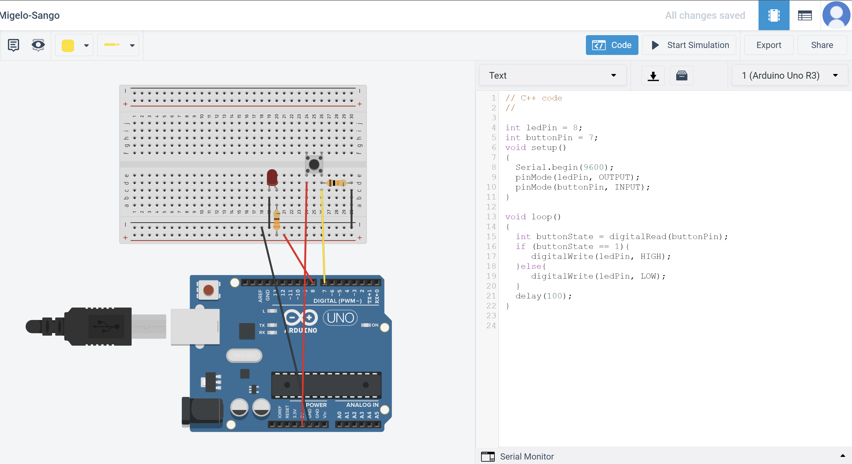
Task 3c, use if else statement to on and off the led
Create a variable for your push button pin
Initialize pin 7 as input
Read value from pin
If button is pressed, light up LED

Slide 47
Task 3c analysis
pinMode as INPUT
digitalRead
Using an if else statement

Slide 48
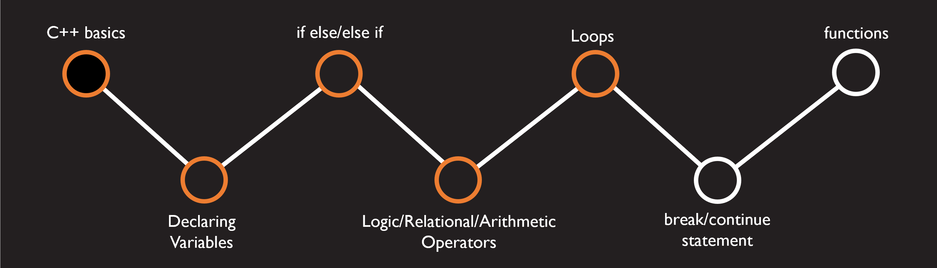
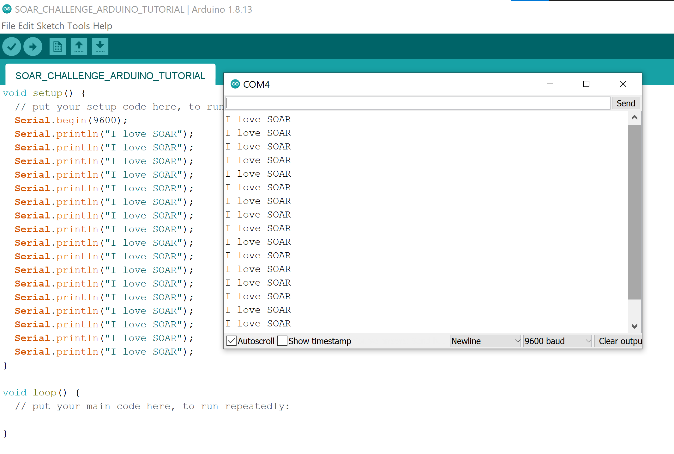
Loops
When you want to keep repeating code, there are better ways than repeating the code you wrote many times, and that is through loops
Even if you love SOAR there are better ways to proclaim your love ;)

Slide 49
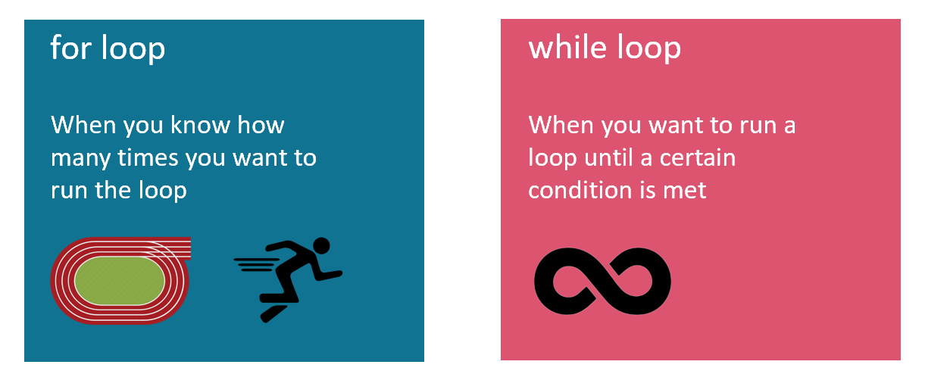
Loops: two types

Slide 50
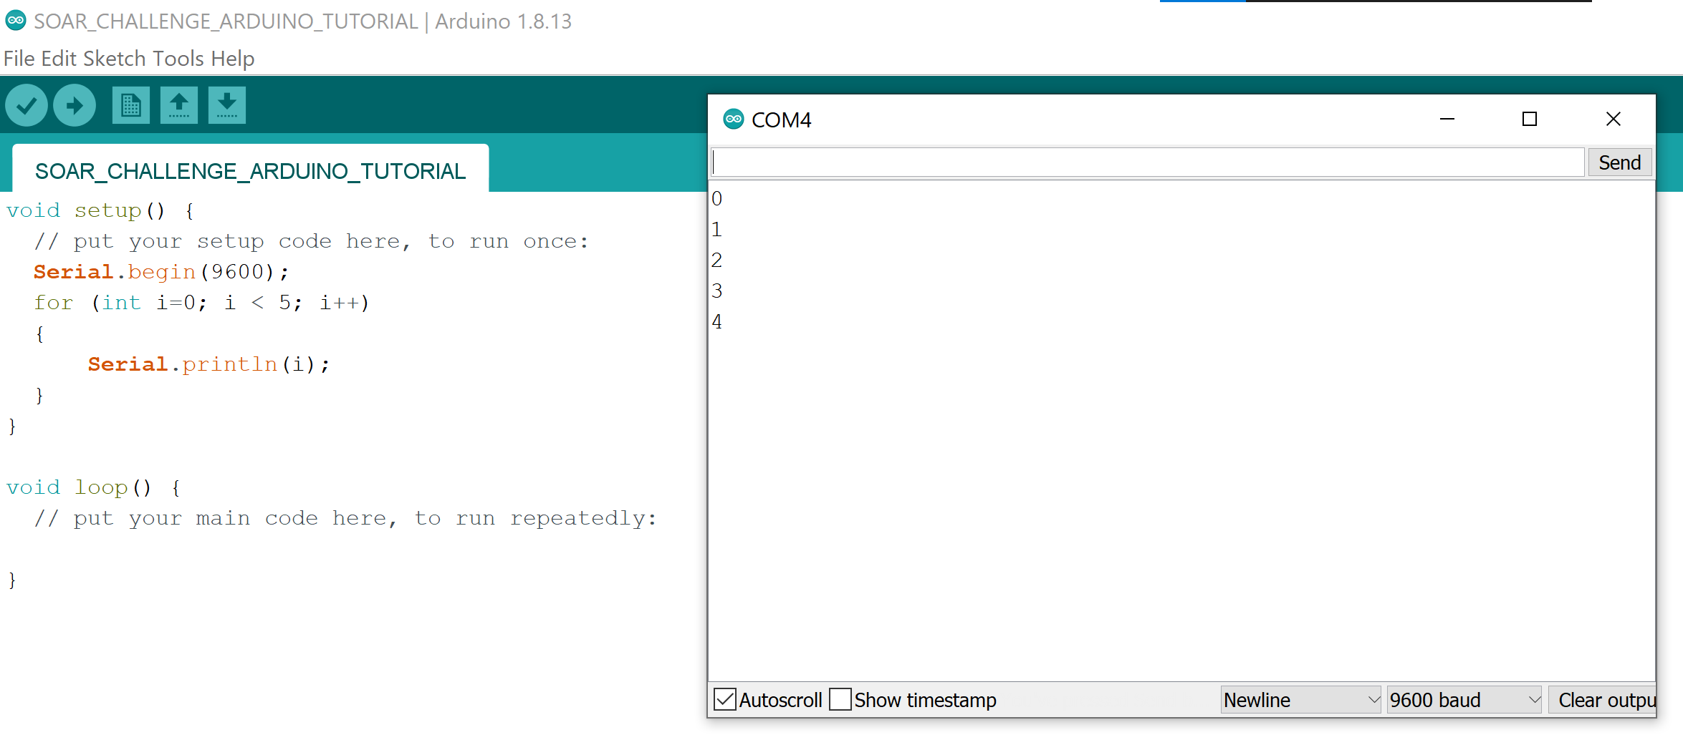
Loops: for loop
Declare variable i
(or any name you like)
Run the loop while i is smaller than 5
Increment i by one everytime the loop is run

Slide 51
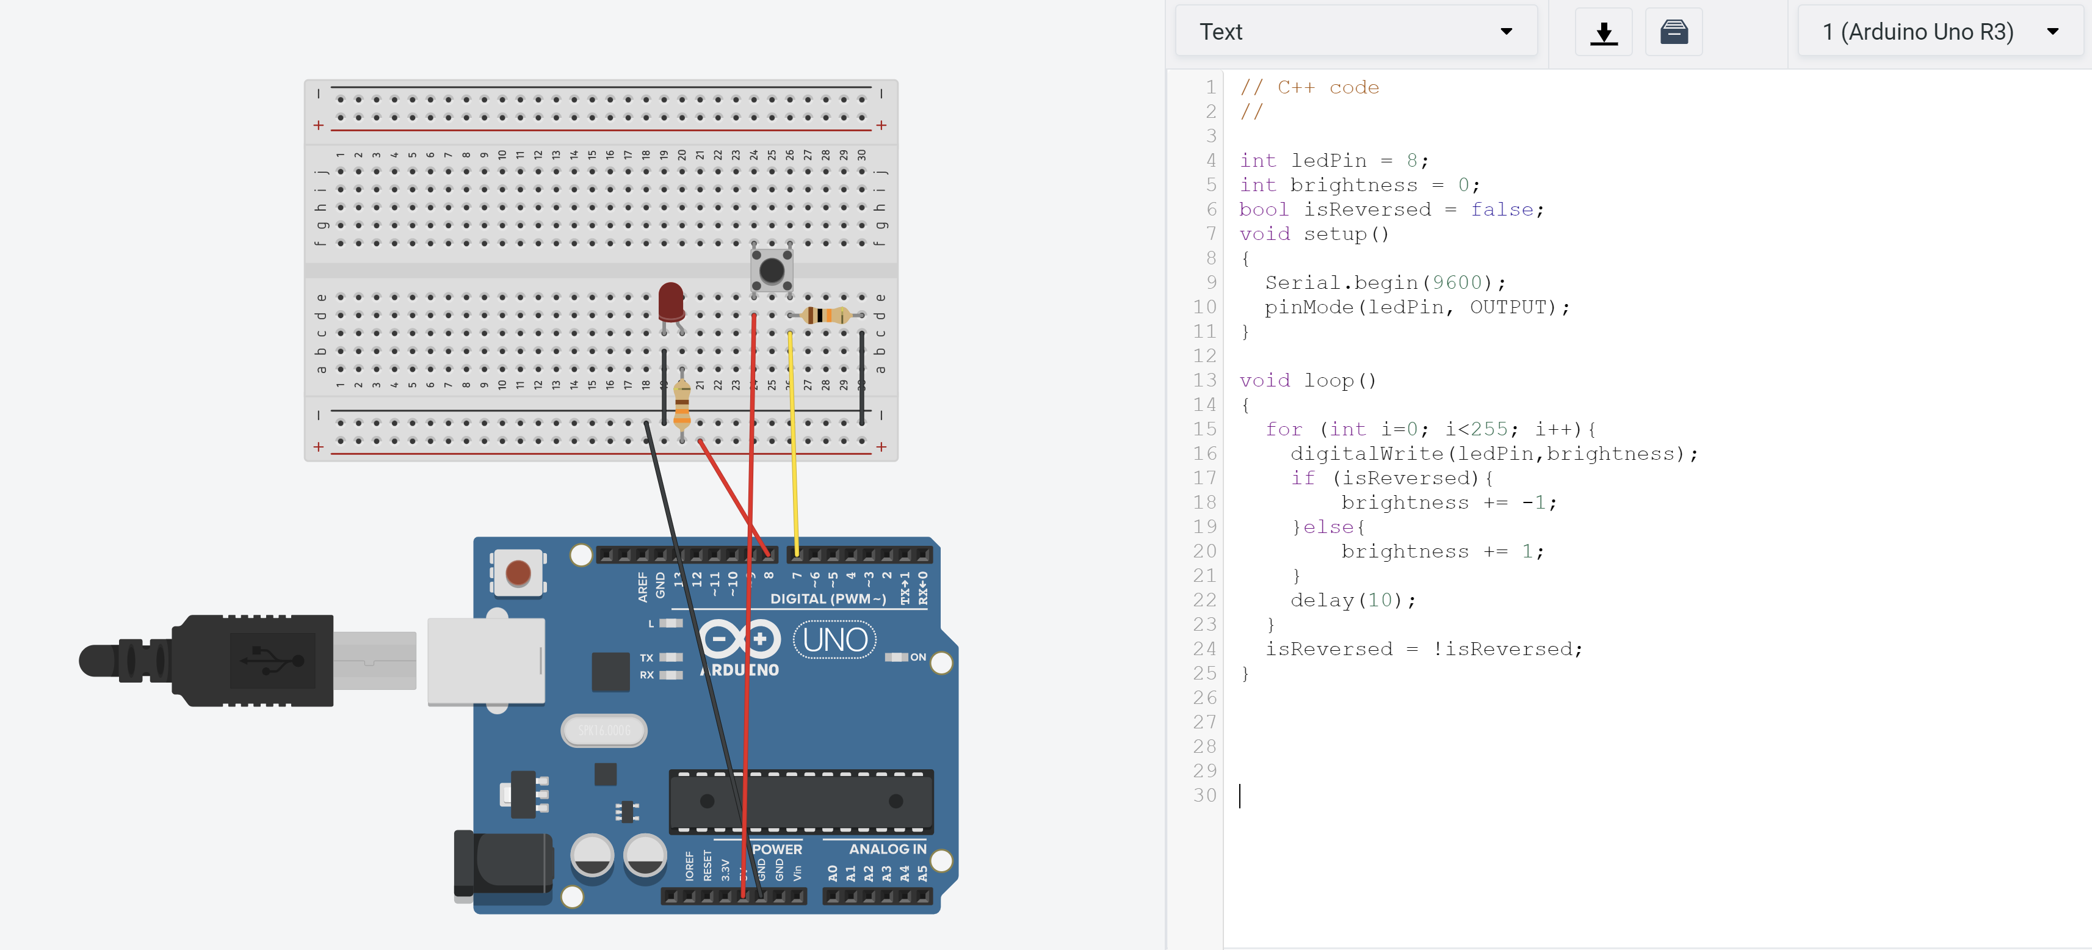
Task 3d, use for loop to increase the brightness of the led and dim it down
Initial LED brightness is 0
Loop 255 times (up to 8bits)
Write brightness value
Decrease brightness if isReversed
increase brightness if not reversed
increase brightness if not reversed
You may notice that your led is not lighting up, what are some of the possible reasons why this code is not working?

Slide 52
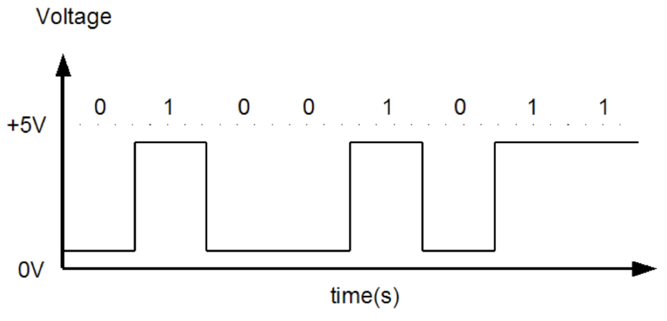
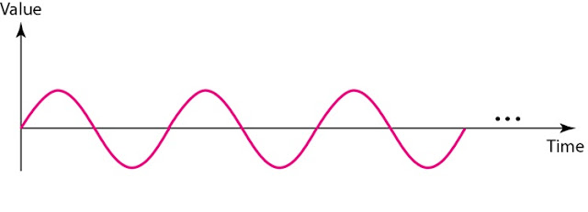
Task 3d, introducing pulse width modulation
What we have been using so far are digital signals, which are available only in 2 states, HIGH and LOW (in Arduino, 5V and 0V)
At most we can on and off our LED, but not adjust its brightness
Analog signals are needed to allow us to vary our voltage supplied to vary the brightness of the led
Digital signal: Two states, high or low
Analog signal, Varying levels of voltage (more than 2)

Slide 53
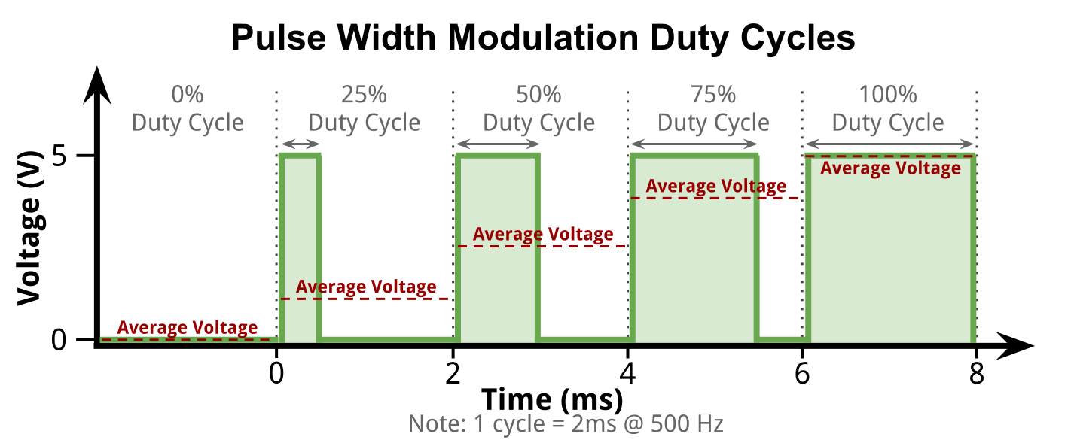
Task 3d, introducing pulse width modulation
However there is reasons why we do not directly use analog signals which is outside the scope of this lesson
As such, Arduino uses pulse width modulation in order to pass information about analog signals
The width of the pulse passes information about the voltage level
If you are interested about how pulse width modulation works in detail you can approach us after class!

Slide 54
Task 3d, recap of what we learnt about pulse width modulation (PWM)
PWM allows us to send analog values (in Arduino case 0-255)
Perfect for allowing us to send different voltage to the LED to give us different brightness
Pins on the Arduino that are capable of sending PWM signals have a squiggly line (~) indicated on them

Slide 55
Task 3d: back to the task of lighting up and dimming the led
Pins with ~ are PWM pins

Slide 56
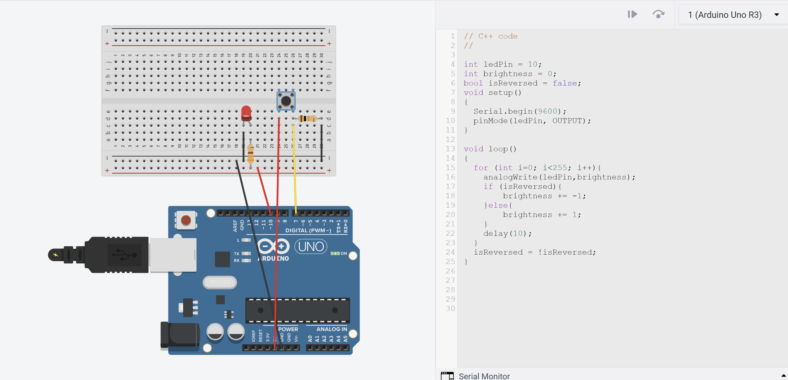
Task 3d: adjusting code to send pwm signals
Change pin number to the new pwm pin that you connected
change digitalWrite to analogWrite
Change LED pin to pwm pin
Note: analogWrite only takes values from 0-255

Slide 57
Task 3d analysis
Learnt about Pulse Width Modulation (PWM)
Identify PWM pins
analogWrite to write values from 0-255 instead of only HIGH and LOW
Learnt how to use for loops
Learnt how to use exclamation mark(!) to change a Boolean value to its opposite value

Slide 58
Task 3e: (Bonus)
In SOAR challenge you would need to create a vehicle that needs to navigate a maze, how would you control the motors of the vehicle?, to explore that, lets try adding a motor to our current circuit

Slide 59
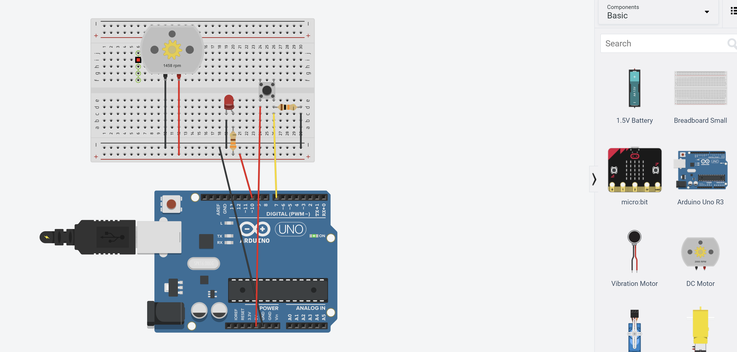
Task 3e (Bonus)
Add a DC Motor and connect the voltage and ground lines to the same lines as the LED and run simulation,
Note how the rpm (revolutions per minute) of the motors changes! In fact changing the speed of a motor is similar to that of changing the brightness level of the led!
Question for thought: analogWrite signal cannot write negative voltage values, how do you reverse the direction of a motor? To be covered in further tutorials

Slide 60
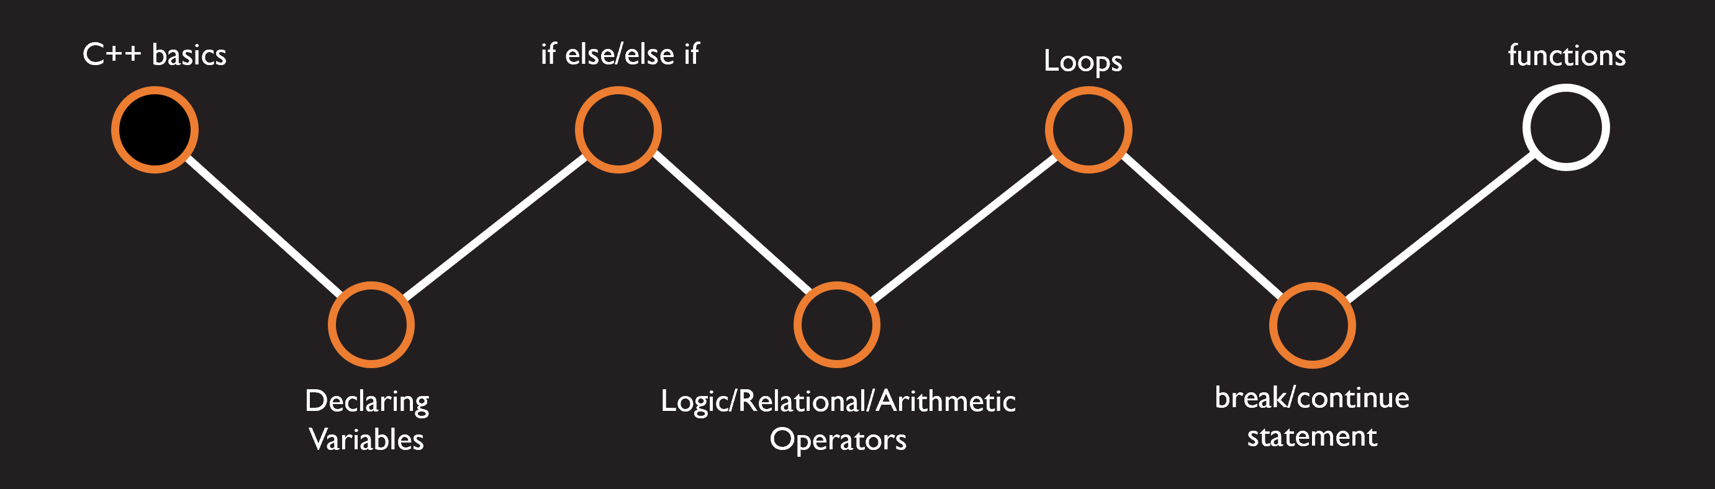
Break:
Writing a break statement will end the current loop prematurely

Slide 61
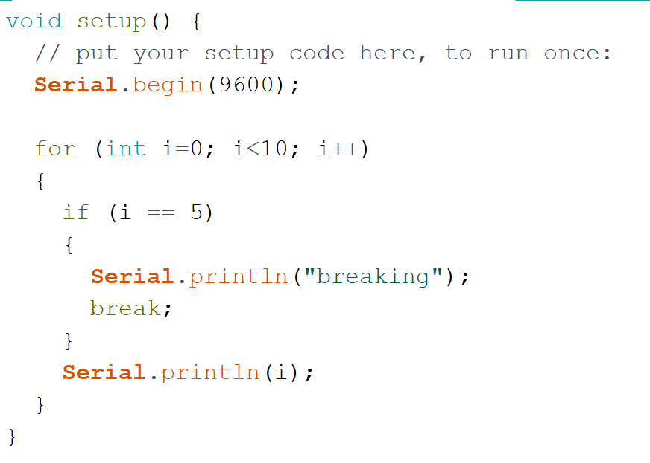
Activity: 5mins
Guess the output of the following code

Slide 62
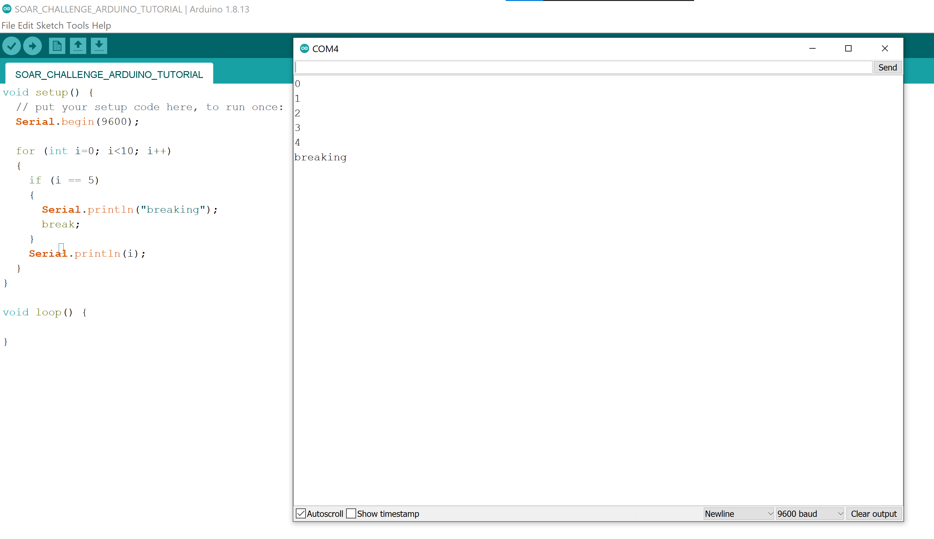
Activity Answer

Slide 63
continue:
Writing a continue statement will skip the current iteration of the loop (ignoring the rest of the code in the loop) and move on to the next iteration of the loop

Slide 64
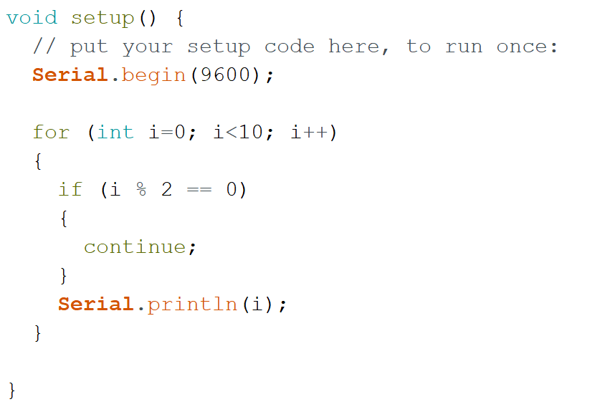
Activity: 5mins
Guess the output of the following code

Slide 65
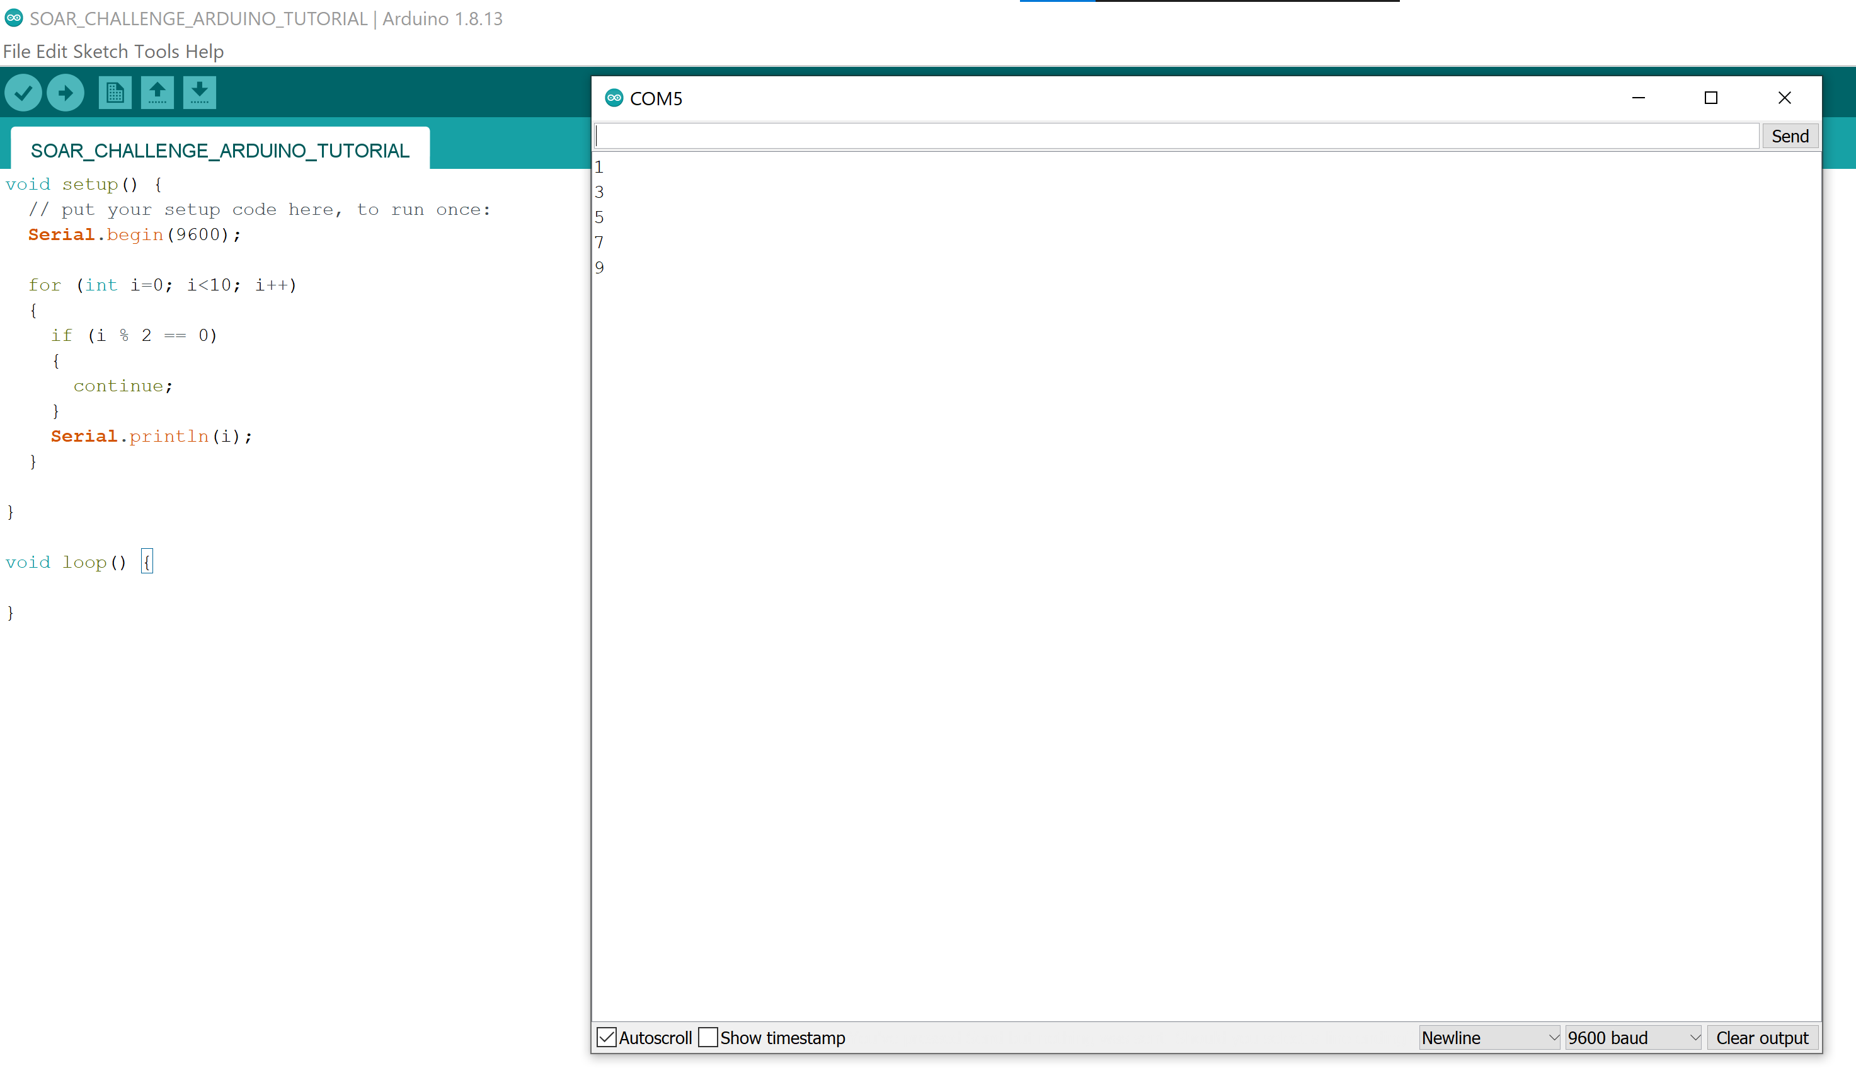
Activity Answer

Slide 66
while loops
While loops run indefinitely until a certain condition is met or a break statement is called

Slide 67
while loops syntax
while (condition)
{
//insert code here
}

Slide 68
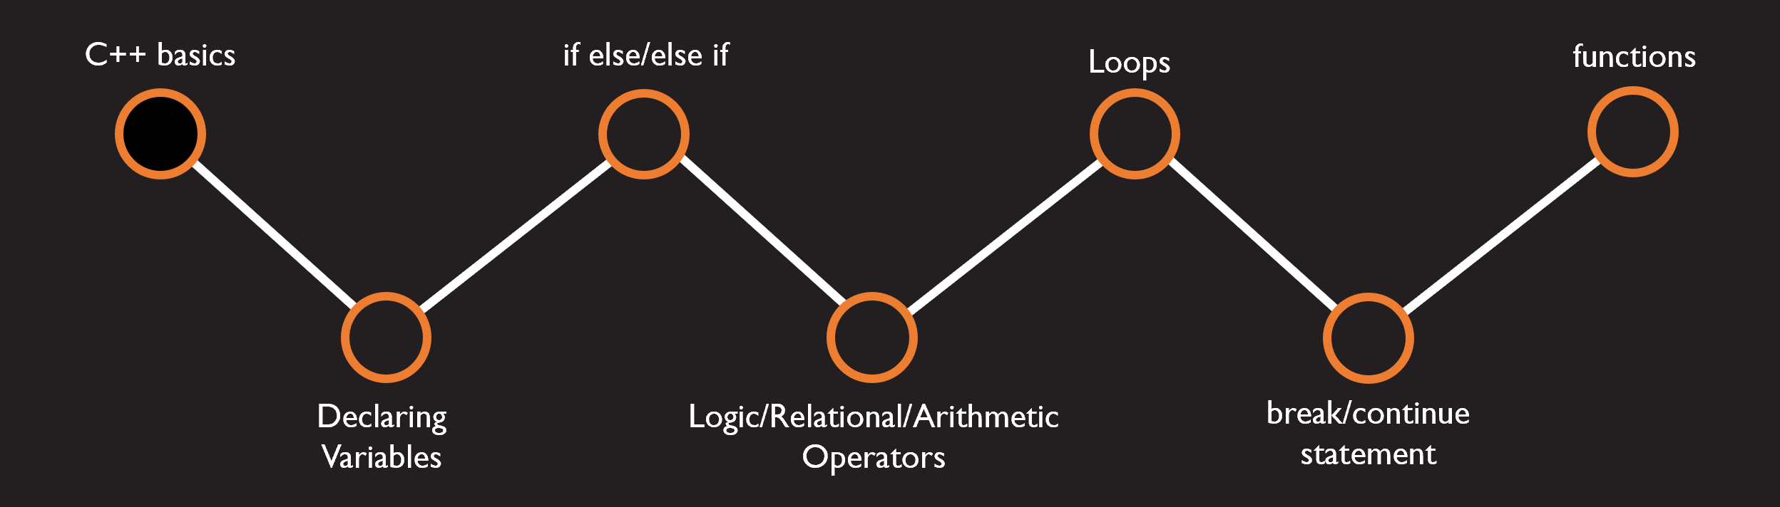
Functions
Grouping up code together
input
output
input
output
input

Slide 69







Functions
input

Slide 70
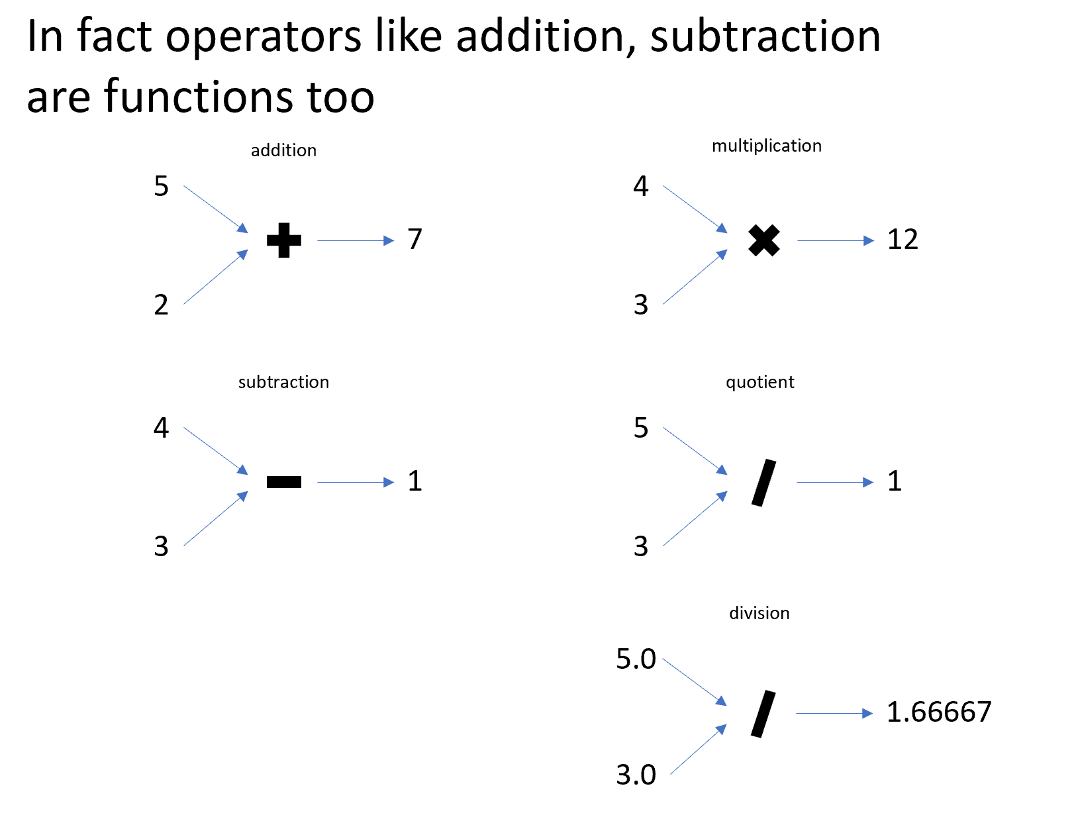
Functions

Slide 71
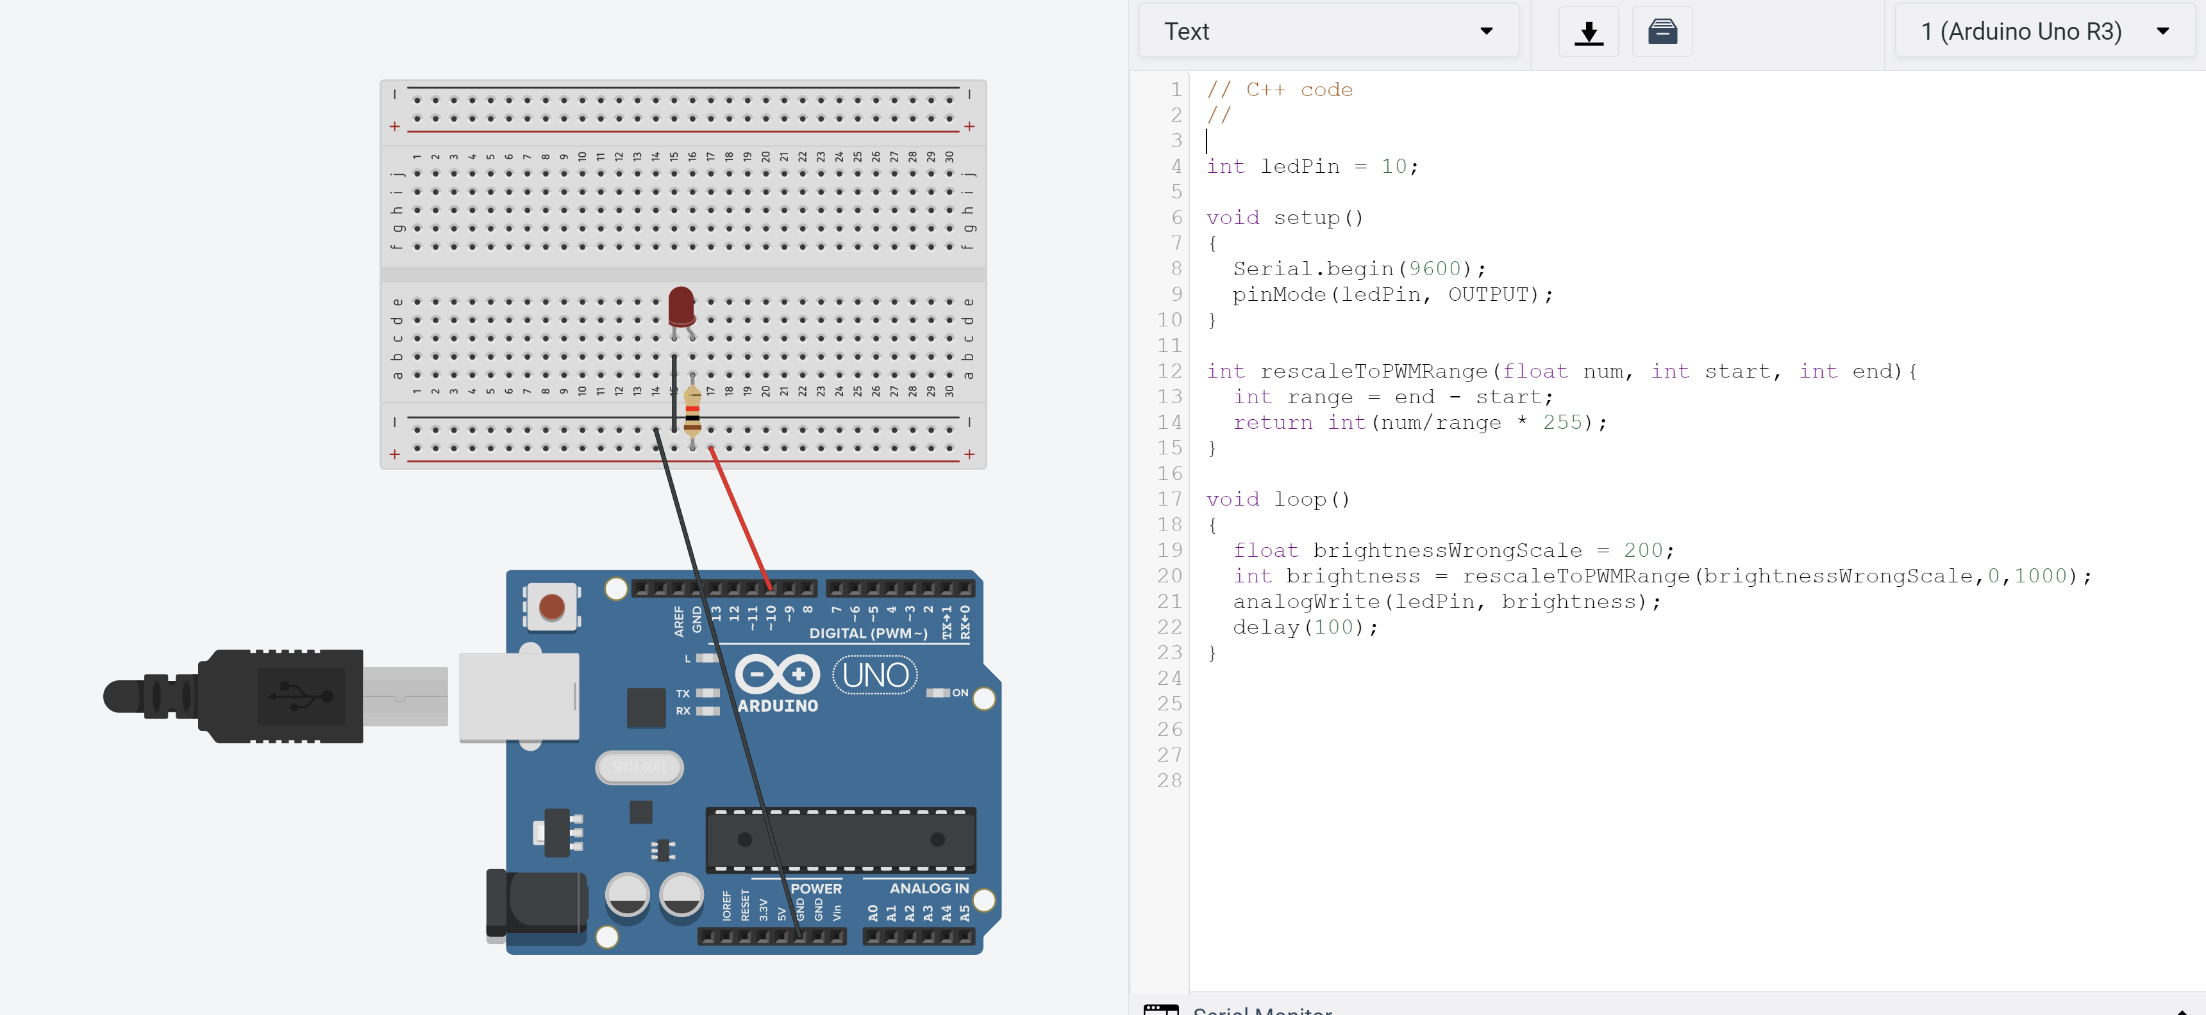
Task 3f: Create a function (will be useful for the final task)
Parameters or inputs to the function
Types must match
These two types must match
Calling the function
Expected return is an int

Slide 72


Great! you are now an Arduino cocoon

Slide 73
Chapter 4:
Analog input
Potentiometer
Final activity

Slide 74
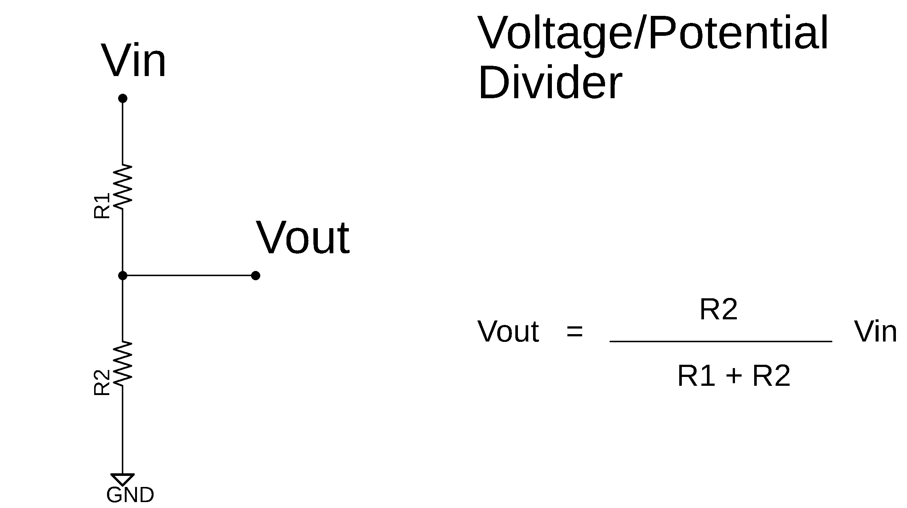
What is a potentiometer
A potentiometer is a three-terminal resistor with a sliding or rotating contact that forms an adjustable voltage divider. If only two terminals are used, one end and the wiper, it acts as a variable resistor or rheostat.
It is effectively a voltage divider

Slide 75





What is a voltage divider
Assume you have 5V, you want to get 2.5V, how do you get do it using hardware (no PWM magic :D)
Use a voltage divider
$$\frac{R_{2}}{R_{1}+R}V_{in}=V_{out}$$
$$Vin=5V$$
$$Vout=2.5V$$
$$\frac{R_{2}}{R_{1}+R_{2}}=\frac{1}{2}$$
$$R_{2}=R_{1}$$

Slide 76


Vin
R1
Vout
Essentially the larger you make this resistor, the more voltage you will get at Vout
R2
GND

Slide 77
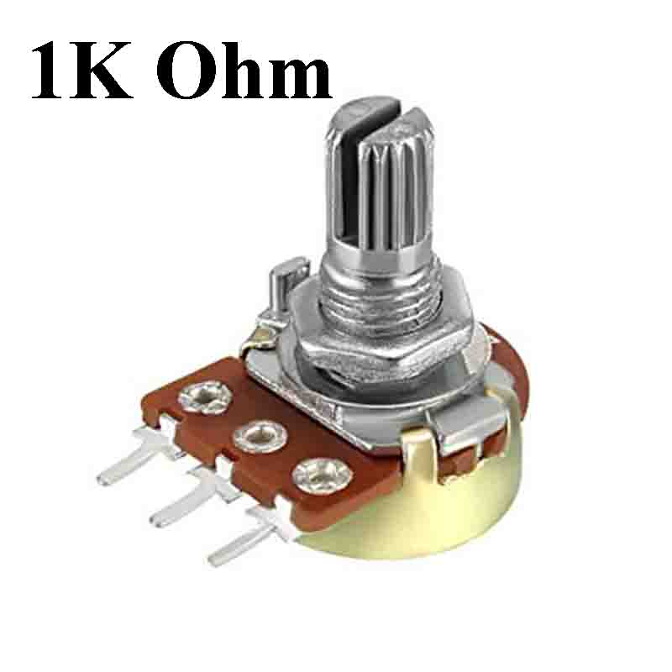
Potentiometer in relation to voltage divider
Essentially, the potentiometer comprises of three terminals, terminal 1, wiper and terminal 2
Knob
Terminal 1
wiper
Terminal 2

Slide 78


Potentiometer in relation to voltage divider
Taking the example of the voltage divider, assume terminal 1 connected to 5V and terminal 2 connected to ground
Vin (terminal 1)
Knob
Terminal 1
wiper
R1
Terminal 2
Vout (wiper)
$$\frac{R_{2}}{R_{1}+R}V_{in}=V_{out}$$
R2
GND (terminal 2)

Slide 79

Potentiometer in relation to voltage divider
Turning the knob moves the wiper and thus determines the size of $R_{2}$ and hence what $V_{out}$ is
Vin (terminal 1)
Knob
Terminal 1
R1
wiper
Vout (wiper) (increases)
Terminal 2
R2
$$\frac{R_{2}}{R_{1}+R}V_{in}=V_{out}$$
GND (terminal 2)

Slide 80
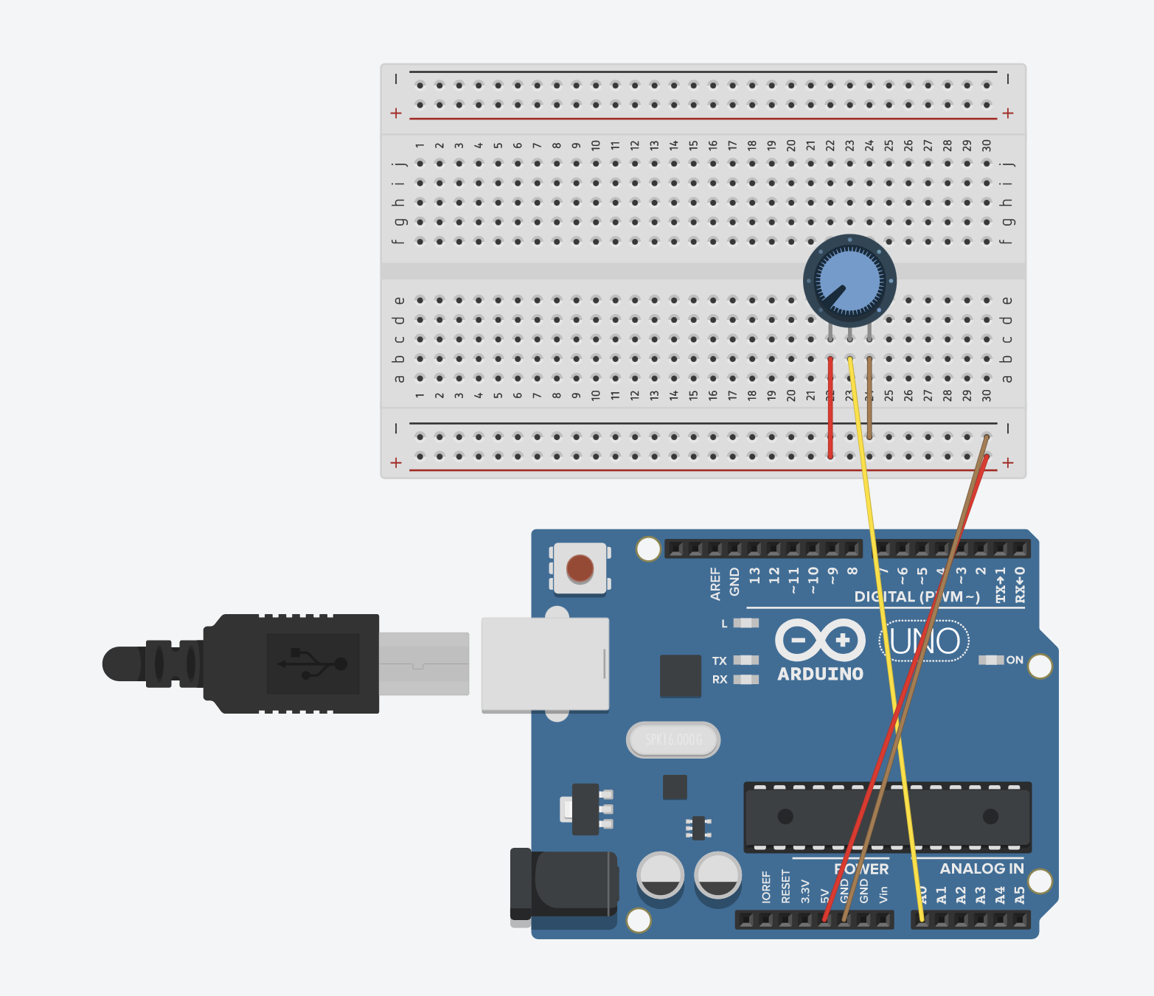
Task 4a: Connect your potentiometer
Connect the potentiometer
Terminal 1 (leftmost) -> 5V
Wiper (middle) -> A0
Terminal 2 (rightmost) -> GND

Slide 81

analogRead

Slide 82
Final Challenge
Goal: use a potentiometer to control the brightness of your led
Step 1: Use a potentiometer to read input (hint: use analogRead, analogRead range is from 0-1023)
Step 2: Use the input read and convert it to a range from 0-255 (hint: use arithmetic operators and use float instead of int to read analog values, also see task 3f for hints)
Step 3: Use the value computed to set the brightness of the LED (hint: PWM, also note that analogWrite only takes in int values, so you must convert the float back to int)
Arithmetic Operators
+ | addition
- | subtraction
* | multiplication
/ | quotient
% | remainder
++ | increment
-- | decrement
Relational Operators
== | Equal to
!= | Not Equal
> | Greater than
< | Smaller than
>= | Greater or equal to
<= | Smaller or equal to
Logical Operators
! | not
&& | and
|| | or

Slide 83

Final Challenge: solution

Slide 84
Where else can we bring this
We saw today that we were able to change the levels of voltage (or electrical signals) to effect different behaviours in our circuit
Many sensors make use of this effect:
Photoresistors changes resistance depending on the amount of light shone on them (similar to how voltage divider splits resistance differently when knob is turned
Ultrasound sends an electrical signal when it receives back the pulse it emitted
Hydrophones and microphone sends out electrical signals depending on the sounds it receives
Similar to how led changes brightness, we can vary output by varying voltage levels:
In motors, the changing the voltage supplied will vary the speed in which it turns (simplistic explanation)
Varying sounds in buzzer

Slide 85


Congrats on finishing C++ with Arduino tutorial!
May you SOAR to greater heights :D

